Slide 1

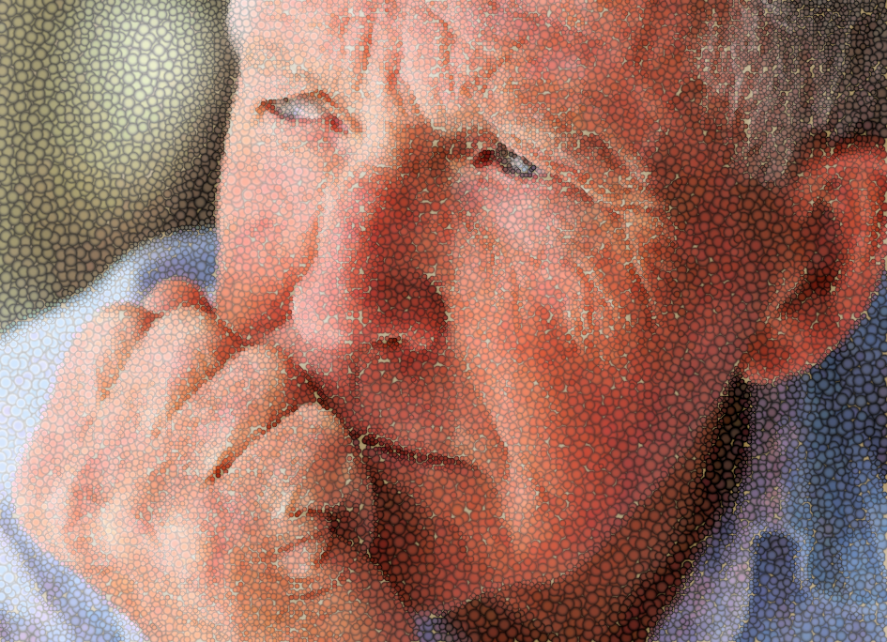
How aged care providers can better support Forgotten Australians and Care Leavers
Notes:
Acknowledgement of traditional owners and any Forgotten Australians or care leavers

Slide 2
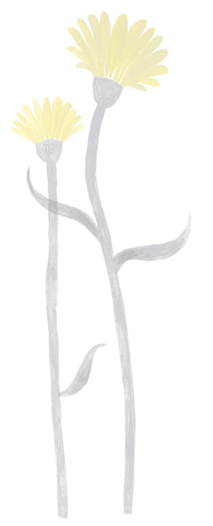

Overview of session
brief service providers on the concerns faced by Forgotten Australians and Care Leavers as they age
introduce the concept of trauma aware and healing informed aged care
introduce the Real Care the Second Time Around resources and their uses and availability
time for questions
Notes:
The purpose of today’s session is to provide information to leaders in the aged care and associated sectors to learn more about: Forgotten Australians and care leavers, the Real Care the Second Time Around Resources, and what trauma aware and healing informed aged care might look like for this group which is identified among people with specific needs in the Aged Care Act 2024.

Slide 3
Sensitivity warning
The following information contains information about abuse and trauma that may be distressing for some people. We encourage you to take care of your health and wellbeing.
Notes:
Before we start, a sensitivity warning – please be mindful of your own wellbeing as we consider the experiences of Forgotten Australians and care leavers during their childhoods and reach out to your support networks if you feel you need to. Reach out to….

Slide 4
Who are Forgotten Australians and Care Leavers?

Slide 5
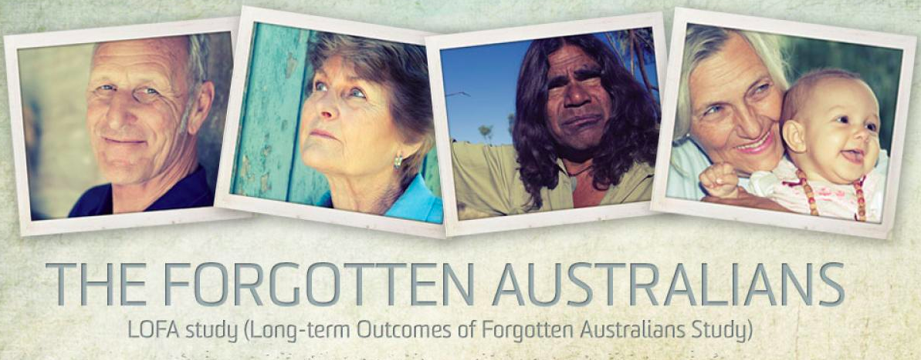
Who Are Forgotten Australians?
  500,000 children in ‘care’ in the last century (1930s-1989)
  440,000 non-Indigenous (Forgotten Australians)
  50,000 Indigenous - some from Stolen Generations
  up to 10,000 former child migrants
Notes:
Who are Forgotten Australians? Over 500,000 children were placed in orphanages and other out of home care in the last century. Collectively, they are known as Care Leavers. Or Forgotten Australians.
50,000 were stolen generations
10,000 were child migrants brought from the UK and Malta
The rest were non-Indigenous Australian children who – for various reasons – could not live with their birth family.
These terms are not universally used however, and we need to be mindful of that. Some people don’t like to think of themselves as being forgotten. Some object to the word ‘care’ as they their childhood experience did not involve any kind of caring. We should always remember to ask whether a person with lived experience whether they have a preferred term – and of course we can’t go too far wrong in calling people by their preferred name.

Slide 6

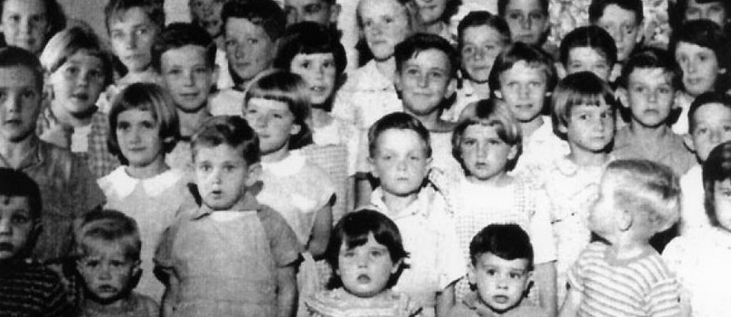
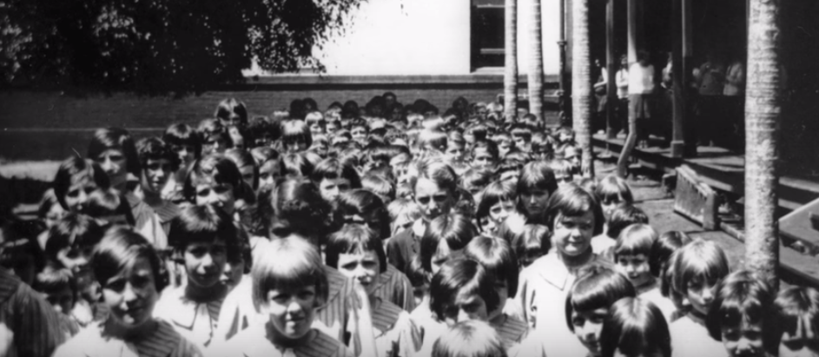
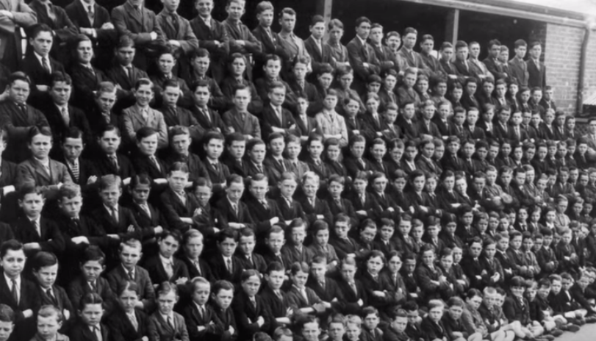
Notes:
But here are some photos from the orphanages, along with a photo from the National Apology given in 2009 by then Prime Minister Kevin Rudd.
Photos usually showed the children dressed in nice clothes, playing and smiling. But the reality was far from idyllic.

Slide 7
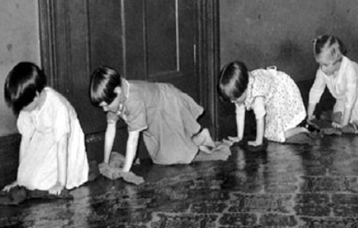
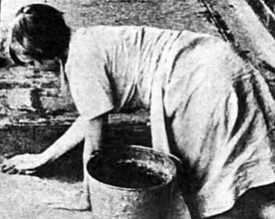
Experiences
Physical, emotional and/or sexual abuse by 'carers’ and/or peers
Loss of family, identity and culture
Neglect (love, food, education, safety, medical care)
Fear, anxiety, abandonment
No possessions – no names
Extreme physical hardship
Humiliating forms of punishment
Notes:
Children in ‘care’ suffered all forms of abuse; siblings were often separated and many children lost their identity and culture – this is particularly relevant for Stolen Generations and Former Child Migrants but also in the practice of calling children by numbers and not their names. For many children who have spent time in institutions, their experiences were characterised by neglect, maltreatment, deprivation and loss of identity, making the transition into adulthood especially challenging.

Slide 8
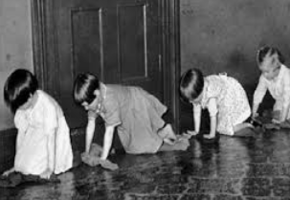
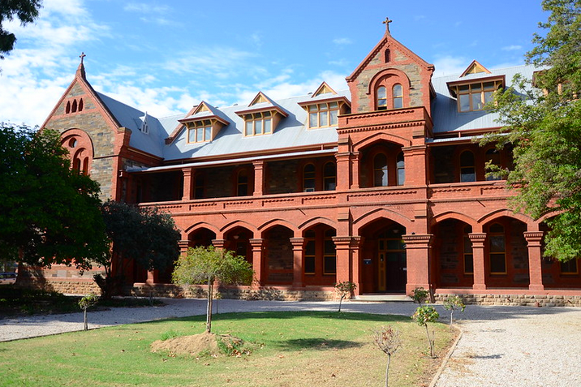
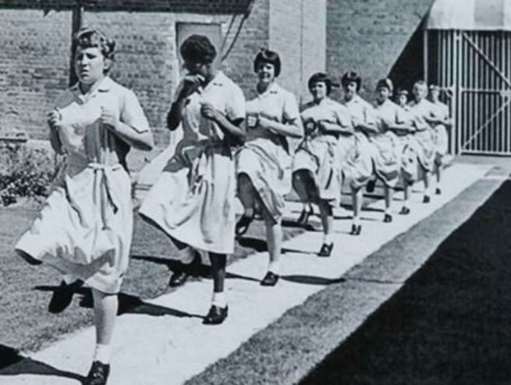
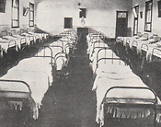
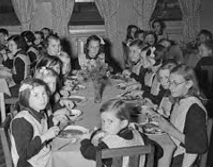
Notes:
Photos of orphanage life – which demonstrate the lack of privacy that children had but also the foreboding and perceptions they many feel about aged care – in particular – residential aged care.
“Institutional care” was a term that referred to the system of residential care for children. Some aged care and other facilities are in the same location as previous orphanages – many names are still the same. A major trigger for Care Leavers is the name of the aged care homes. Some aged care homes have the SAME names as the Orphanages that Care Leavers were once in e.g. St Joseph’s, Roslyn Hall and St Catherine’s, to name a few examples.
These experiences have had a lifelong impact.
Which is why “trauma aware and healing informed” form such a strong part of the Aged Care Act 2024 and the Strengthened Standards.

Slide 9
What are the barriers to accessing aged care?
The lifelong impacts of complex trauma

Slide 10

Impact of experiences in care
Barriers to accessing support:
Aged Care (and society more broadly) unaware of group / trauma
Fear of re-institutionalisation
Trusting – aversion to ‘authority’
Many left ‘care’ illiterate and innumerate
Lack of information about services
Dealing with conflict / solving problems /
communicating / making a commitment
PTSD (76%*) / anxiety / depression / health
Guilt and shame = non-disclosure / stigma
Intergenerational trauma including domestic violence
*Long Term Outcomes for Forgotten Australians (2017 UNSW)
Notes:
Childhood trauma has consequences and they have led to barriers to accessing support for this group – which is the reason the Real Care the Second Time Around Project exists. Those barriers include: an aged care and health care sector who are largely unaware of the history and experiences of this group; a deep fear of re-institutionalisation by Forgotten Australians/Care Leavers; a deep and longstanding aversion to authority – particularly Government; and PTSD, anxiety, depression and other chronic and multiple comorbidities – and guilt and shame experienced by many Forgotten Australians that has led to non-disclosure and of course compounds the trauma they feel.
Delay in accessing community based care = acute care required.

Slide 11
What is the Real Care the Second Time Around project?

Slide 12
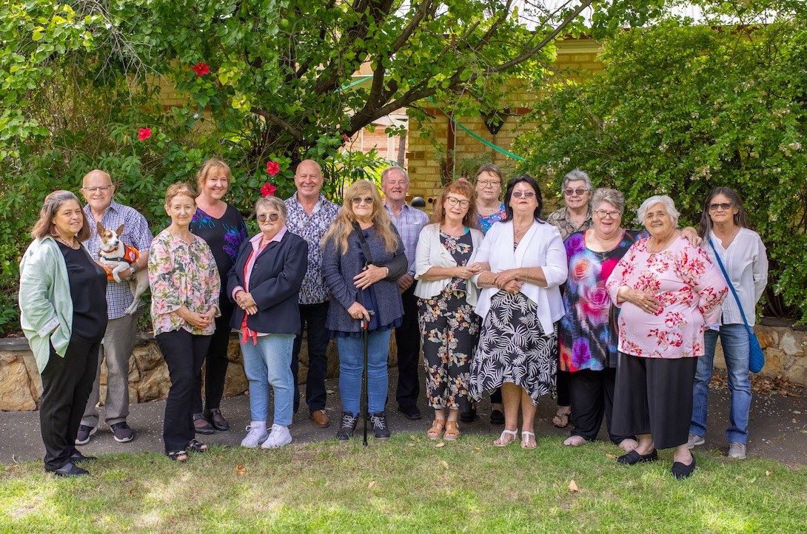
Real Care the Second Time Around Project
Commonwealth funded project
2019-2021 Pilot / 2022-2024 roll-out outcomes nationally
Partners: Flinders University, Relationships Australia South Australia (Elm Place)
Advisory Group
Co-design Expert Panel of Forgotten Australians
Notes:
Real Care the Second Time Around is a Commonwealth funded project which commenced in 2019. Helping Hand partnered with Flinders University and Relationships Australia South Australia and had a co-design expert panel of people who identify as Forgotten Australians.

Slide 13
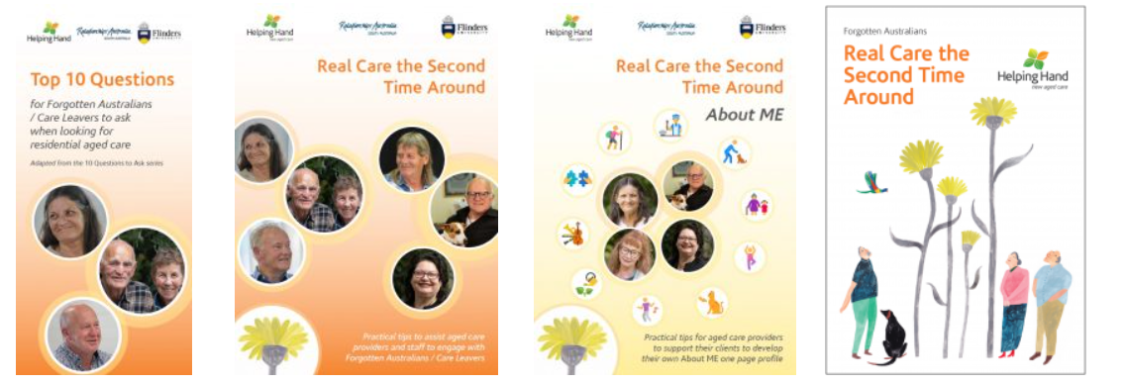
RCSTA resources
Two training modules: Working with aged care clients who experienced childhood trauma in ‘care’ and Having respectful and inclusive conversations with older people from a background of trauma
Refresher training to meet annual training requirements
Podcast - another useful training resource
Debrief guide
Short scenario videos
Tips for service providers
Resources for Forgotten Australians and Care Leavers
Access via: https://www.helpinghand.org.au/about-us/diversity-inclusion-belonging/forgotten-australians/
Notes:
The following resources have been developed and are all available free on the Helping Hand website.

Slide 14
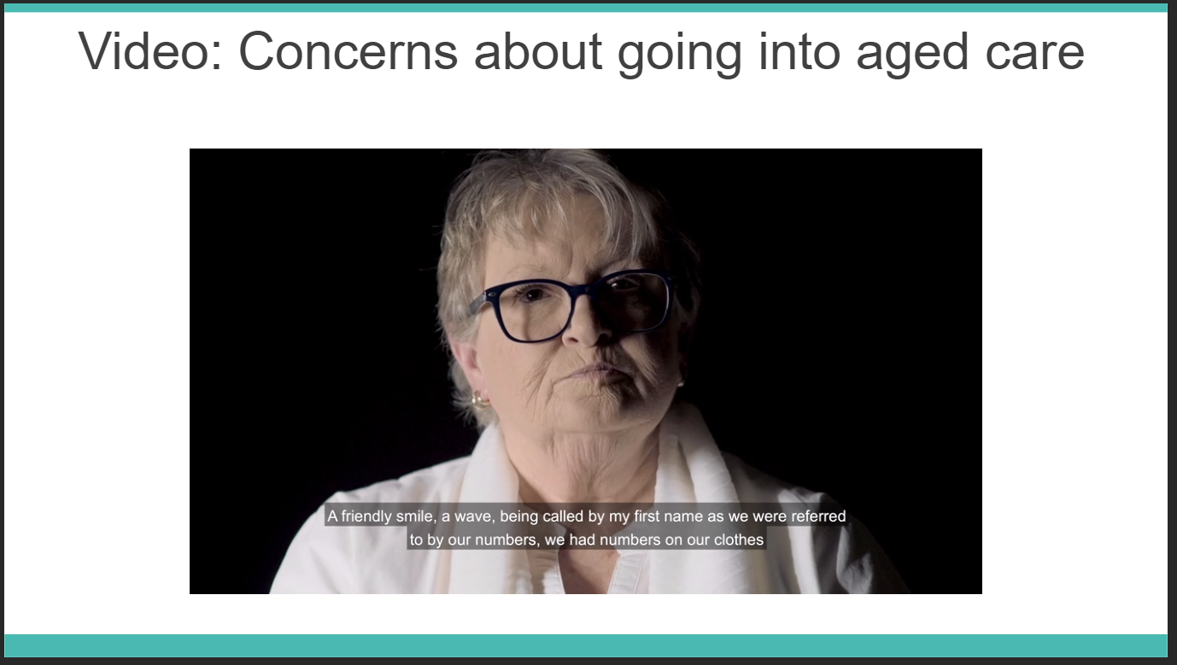
Notes:
The website contains some short videos to introduce this topic, with the words of the Forgotten Australians themselves.

Slide 15
What does Trauma Aware and Healing Informed Care look like?

Slide 16
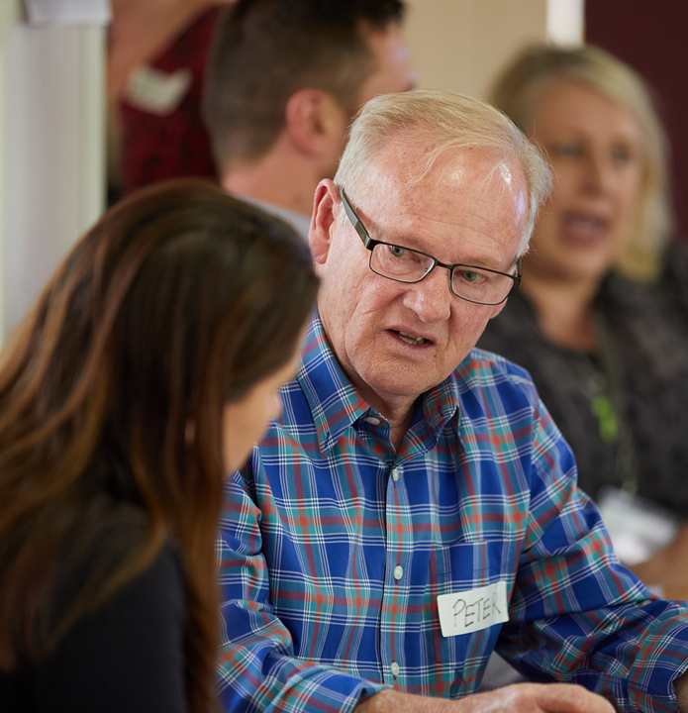
Achieving safe and inclusive care
Establish trust and safety
Providing peer support
Sharing power - collaboration
Respecting personal space
Choice and voice
Flexible service delivery
Respecting diversity
Understand impact of trauma
Understand history and experiences
Identify Forgotten Australians at intake / assessment
Notes:
Developing TRUST is critical for people from complex childhood trauma, so providing a safe environment and staff with trauma informed skills is conducive to creating trust, safety, confidentiality and consistency. Creating trust, giving people choice and working collaboratively with them is key.
(no need to read through dot points)

Slide 17
Practical tips
Use people’s names – not ‘love’ or ‘dear’
Provide consistent care team as much as possible
Keep clients/residents advised if something needs to changes in their care
Provide options for what and where to eat
Ask for gender preferences in the provision of care, especially personal care
Recognise aggressive behaviour as possibly being linked to trauma
Don’t move people’s possessions around unnecessarily
Respect privacy and preferences – doors open/closed, knocking
Give choice as much as possible – e.g. shower times, mealtimes
Provide alternatives to participation in group activities, including, for example, Christmas or Mother’s Day, which can be triggering
Notes:
Here are some things you can do TODAY that will move you towards the provision of trauma informed care for Forgotten Australians and careleavers.
(Pick a few dot points to call out)

Slide 18
Embedding trauma aware and healing informed care
Champion the work in your organisation; formalise the appointment of Champions
Undertake the training yourself and encourage others to do the same
Run/participate in debriefing sessions following the training
Engage leadership in discussions of trauma informed care
Engage teams and workgroups in discussions of trauma informed care
Commit to embedding trauma informed care in your services
Support staff who may have strong emotional responses
Ask the questions, listen to the answers – Intake, lifestyle planning, support
Make this an active part of your service delivery model
Connect with local care leaver support services – have information available
Connect with your local ecosystem on trauma informed care
Seek specialisation verification!
Use the toolkit https://unitingcare.org.au/media-release/statement-of-commitment-to-trauma-informed-aged-care-forgotten-australians-and-care-leavers/
Notes:
Here are some points for how your organisation can move towards embedding trauma aware care.

Slide 19
Helping Hand Aged Care
1300 653 600
www.helpinghand.org.au
www.helpinghand.org.au/about-us/diversity-inclusion/forgotten-australians/
Chelsea Lewis clewis@helpinghand.org.au
Notes:
Here are links to the resources and further information. These are also in the chat box.
Chelsea Lewis at Helping Hand is the project manager for this work and you are very welcome to get in touch with her if you have follow up questions or would like to obtain hard copies of the resources.

