Slide 1

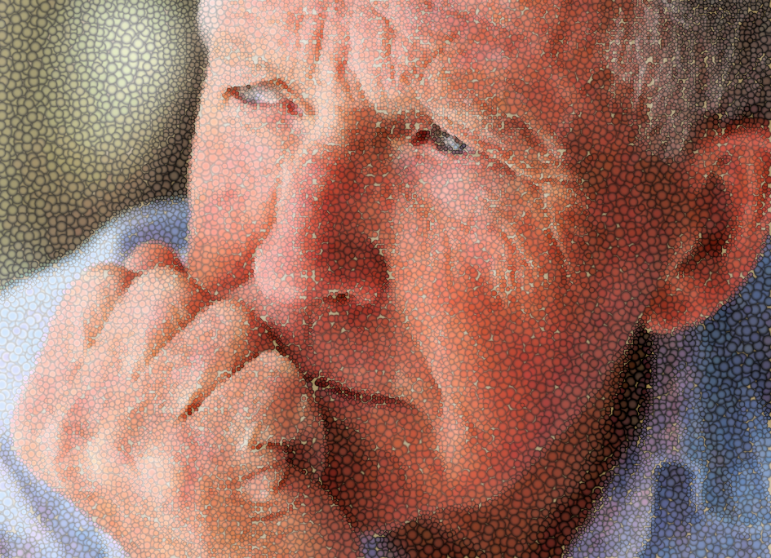
Trauma informed aged care for Forgotten Australians and Care Leavers
Notes:
Welcome
Acknowledgement of traditional owners
Acknowledgement of Forgotten Australians and Care Leavers
Presenter intro

Slide 2
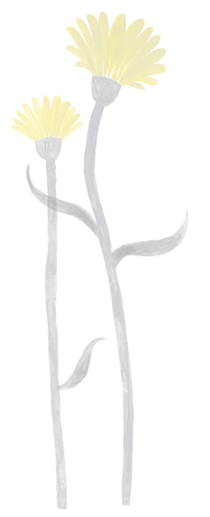

Sensitivity warning
The following information contains information about abuse and trauma that may be distressing for some people. We encourage you to take care of your health and wellbeing.
Aboriginal and Torres Strait Islander people should be aware that this training contains images, voices and names of deceased persons.
Support: 13YARN
Lifeline 13 11 14
EAP
Notes:
Note: if a person discloses a care or trauma history or connection during a presentation, thank them for sharing and welcome their input as appropriate. Connect with them in a break and at the end of the session (if possible) to check how they are doing and whether they need any support. They may wish to add contributions
Key points:
Please be mindful of your own wellbeing as we consider the experiences of Forgotten Australians and care leavers during their childhoods and reach out to your support networks if you feel you need to. Take a break during the session if needed.
Acknowledge potential impact for First Nations persons
Refer to employee assistant program as relevant

Slide 3
Welcome
Acknowledgement
Introductions
Notes:
Note: you may like to tell the group whether you have lived experience or not (optional – but as appropriate, acknowledged that you are not speaking on behalf of care leavers)
Introductory activity:
Ask people to introduce themselves and their role – and ask: If you were turning ten this year, what would you ask for for your birthday?
Purpose: a light, fun activity that also brings the voice of the child into the room; echo back through session – what would it have been like to have a birthday as a child in care…

Slide 4
Overview of sessions
Session 1
Building leadership capability and confidence
Building knowledge of Forgotten Australians and care leavers and the issues they can face in aged care
Notes:
Key point:
If you haven’t heard the term Forgotten Australian or care leaver, that’s ok – we will go into detail.

Slide 5
Overview of sessions
Session 2
What does trauma aware, healing informed practice look like?
Practical tips
Working with the team
Resources available

Slide 6
Overview of sessions
Session 3
What does this mean for us?
Leaders
Staff
Residents
Challenges

Slide 7
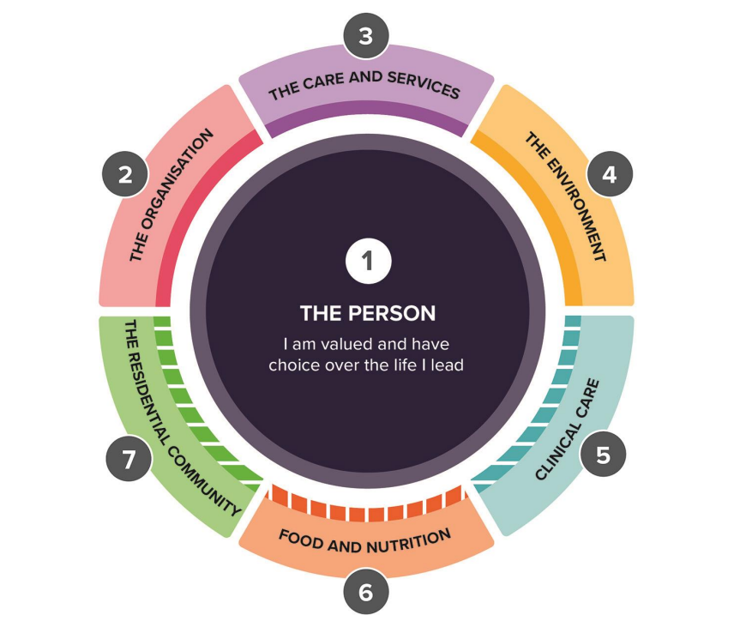
Why…
New Act and Strengthened Standards
A human rights-based approach
Key principles
Dignity and respect
Autonomy and participation
Non-discrimination and equality
Safety and protection
Quality of life
Notes:
Key points:
Apart from being the right thing to do (if relevant - especially as a faith based organisation where there may have been direct involvement with the types of harms we will discuss)…
…the new Acts and standards implement a human rights based approach to aged care
Including…

Slide 8
Strengthened Standards
Standard 1. The provider implements strategies to:
a) identify the older person’s individual background, culture, diversity, beliefs and life experiences as part of assessment and planning and use this to direct the way their care and services are delivered
e) deliver care that is culturally safe, trauma aware and healing informed, in accordance with contemporary, evidence-based practice
Notes:
Key points:
New standard 1 says that person centred care means that we will all understand and value the person and their life experiences – and that we will tailor care and services that uphold their rights. And that as providers – we will know the person and their story, and very specifically - deliver care that is culturally safe, trauma aware and healing informed, in accordance with contemporary, evidence-based practice.

Slide 9
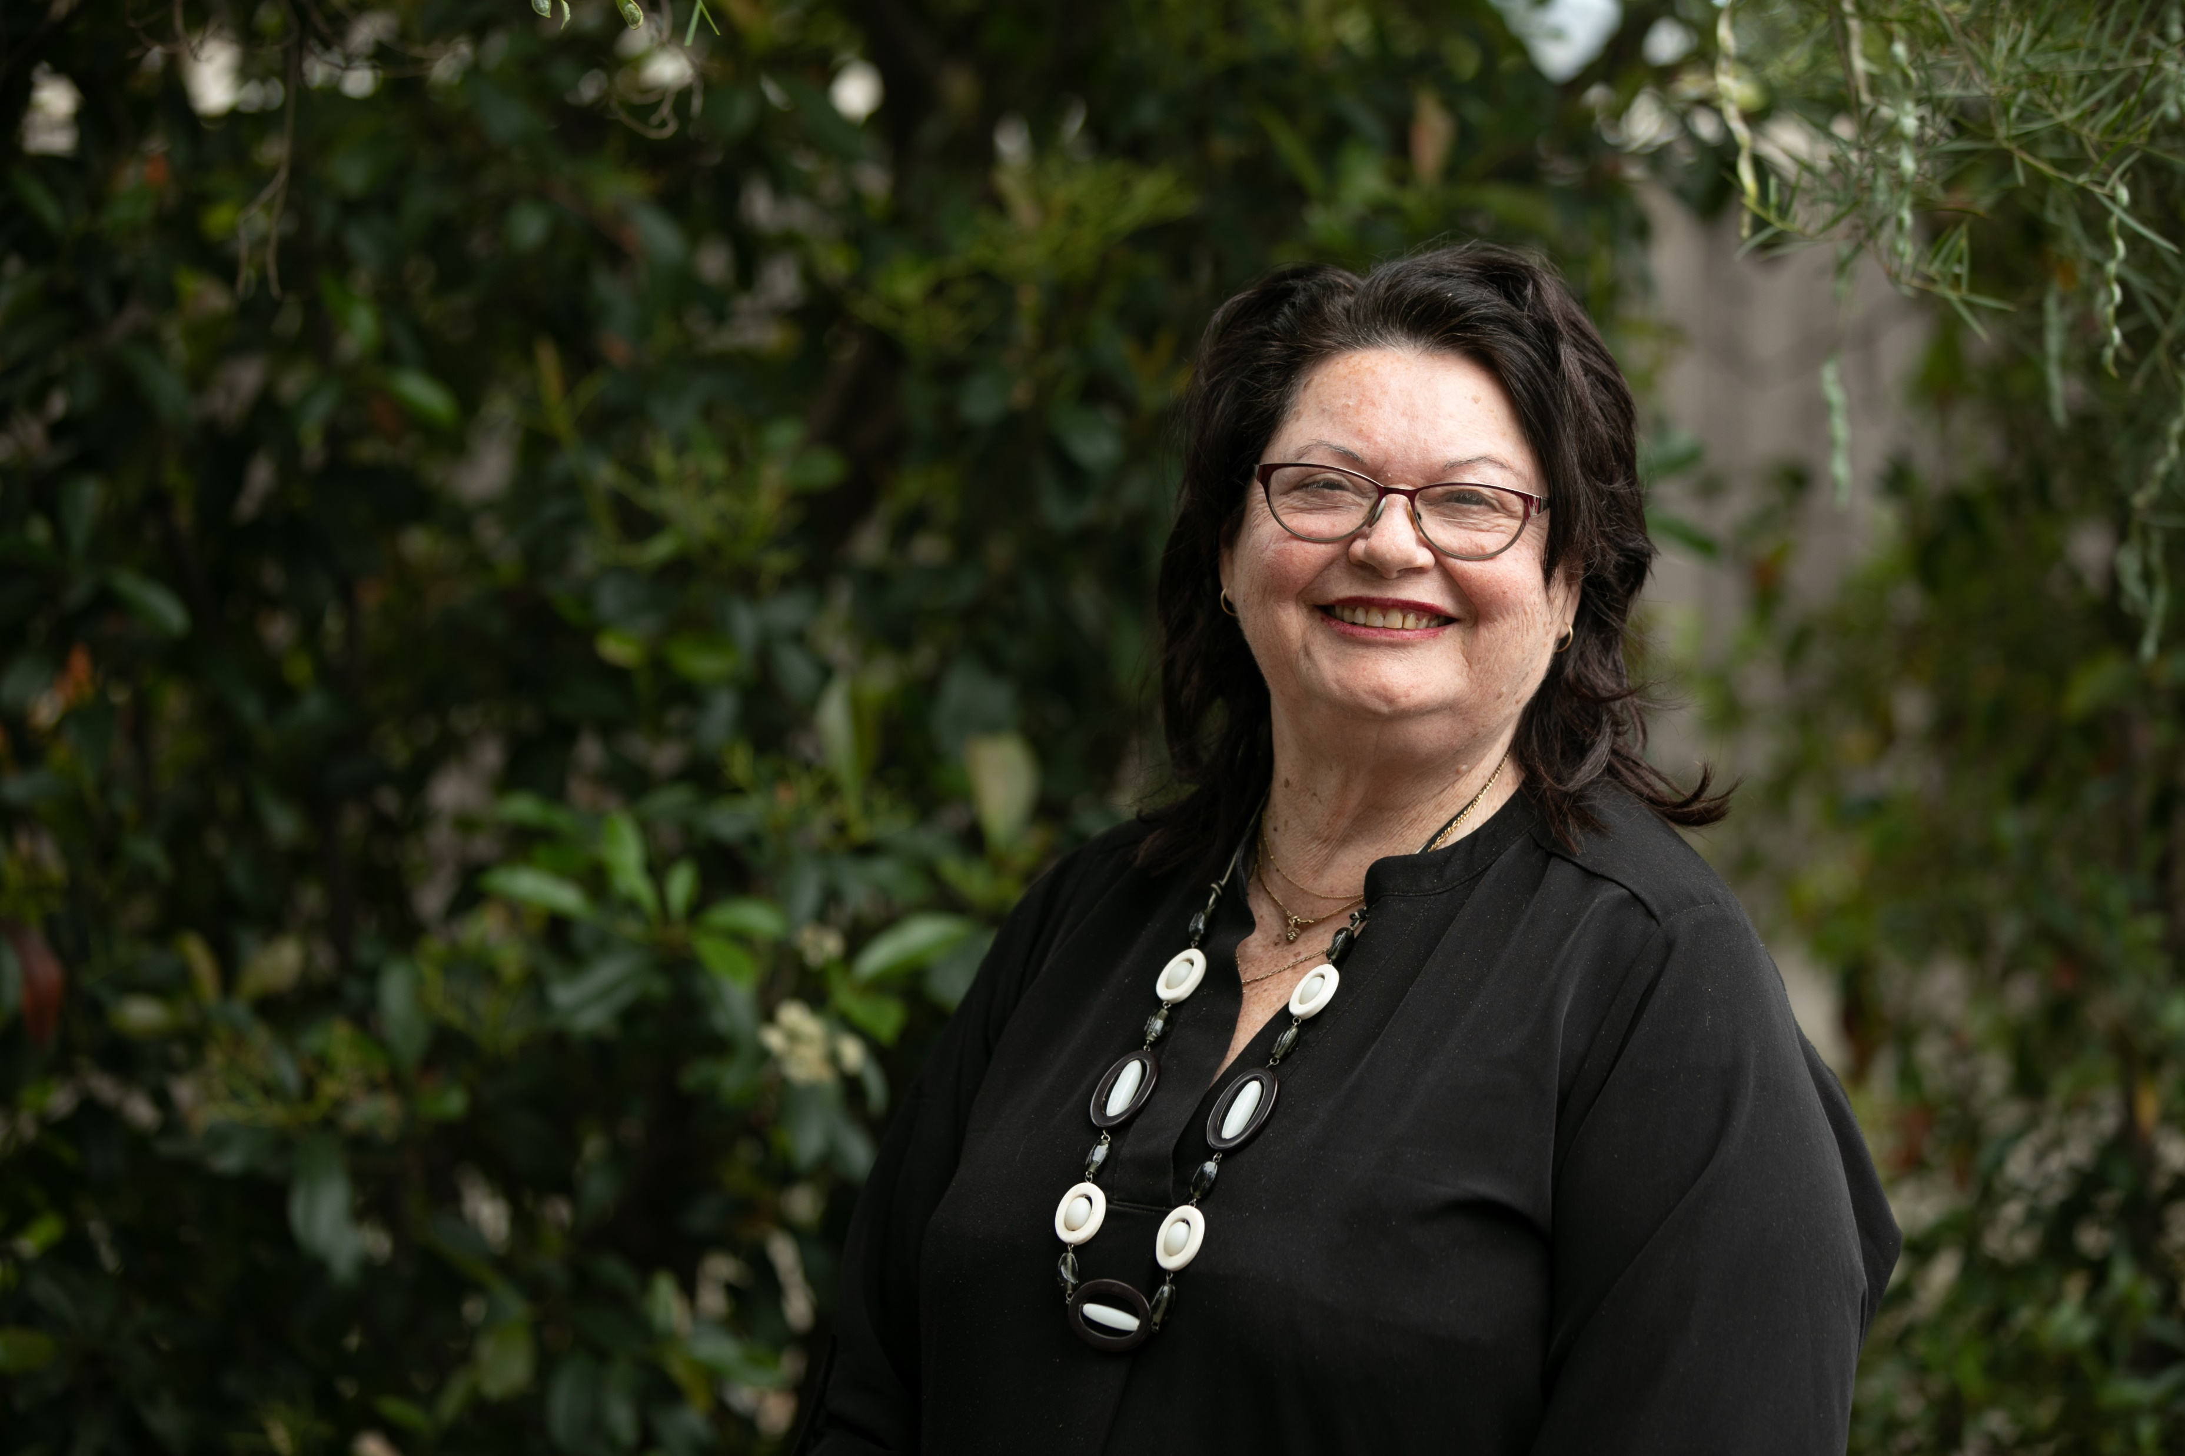
New Act
  An individual has a right to equitable access to: ​
  have the individual’s need for funded aged care services assessed, or reassessed, in a manner which is culturally safe, culturally appropriate, trauma-aware and healing-informed.​
Notes:
Note: This is Priscilla, one of Forgotten Australian co-designers.
Key points:
The Act also makes specific reference to culturally safe, culturally appropriate, trauma aware and healing informed.
What does that mean?​
Trauma-aware and healing- informed practice requires organisations to understand the manifestation of past and current trauma, and then make changes to take an active role in championing healing, wellbeing, and subsequently closing the gap. Being culturally aware is simply not enough.
So this is a big change for Providers …

Slide 10
Who are Forgotten Australians and Care Leavers?
Session 1
Notes:
Key points:
The terms “Forgotten Australians” and “Care Leavers” aren’t used by everyone who has this experience.
When we talk about “care” here, we are talking about the care system that looks after children when they can’t or don’t live at home with their families.
Today, this usually looks like foster or kin care.
But back in the 1900s kids were taken into orphanages, missions or group homes.
So someone who has been in that system as a child and has left the system is a “care leaver”.
The term “Forgotten Australian” was adopted by the Senate when they conducted in inquiry into abuse in care in the early 2000s.
Some people don’t like these terms – some object to being called a ‘care leaver’ because they didn’t experience any thing like ‘care’. Others don’t like to think of themselves as ‘forgotten’.
Terms can be important so if we are working with someone who discloses a care history, we can ask them if they know about and have a preference for either of these terms – or something else. Or we just make sure we call people by their names.

Slide 11
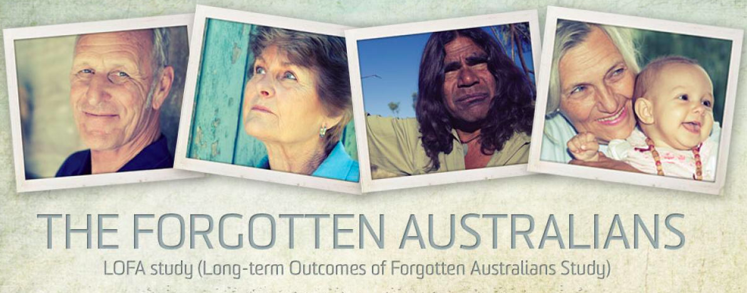
Who Are Forgotten Australians?
  500,000 children in ‘care’ in the last century (1930s-1989)
  440,000 non-Indigenous (Forgotten Australians)
  50,000 Indigenous - some from stolen generations
  up to 10,000 former child migrants
Notes:
Key points:
Who are Forgotten Australians? Over 500,000 children were placed in orphanages and other out of home care in the last century.
The timeframe is from the early 1900s up to around 1990 which is when the care system shifted to be more professionalized – with youth workers and social workers involved in the care of children, rather than nuns or missionaries or ‘house parents’
Around 50,000 were stolen generations – where Aboriginal and Torres Strait Islander children were taken from families and communities under racist government policies. They were often never allowed to return to community, to speak language or to practice culture.
10,000 were child migrants brought from the UK and Malta – some from orphanages and some from families. They were promised a happy life in Australia but that was far from the reality for many people/
The rest were non-Indigenous Australian children who – for various reasons – could not live with their birth family. The removal was often related to poverty – too many mouths to feed – or family complexity – mum or dad was ill or passed away, perhaps violence in the home, dad may have returned from war with PTSD, or their was substance abuse or mental illness in the home

Slide 12
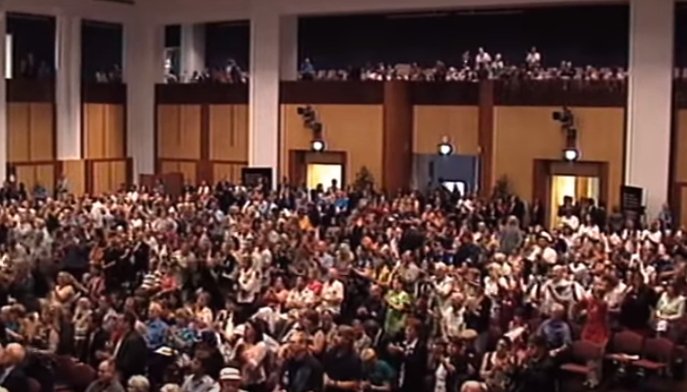
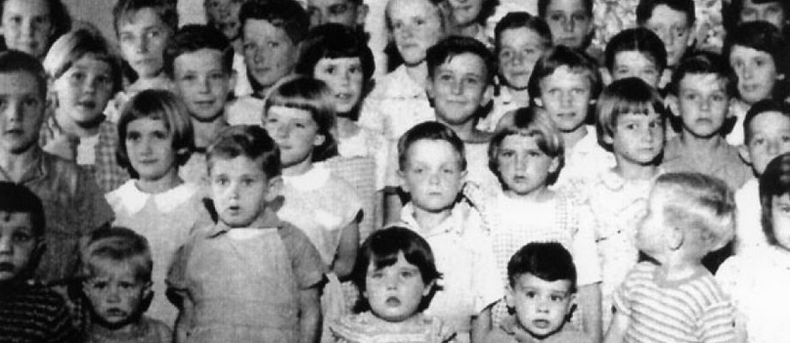
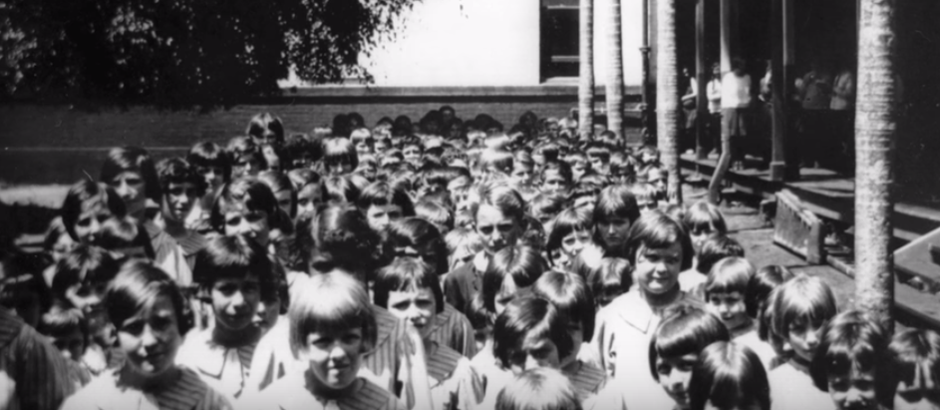
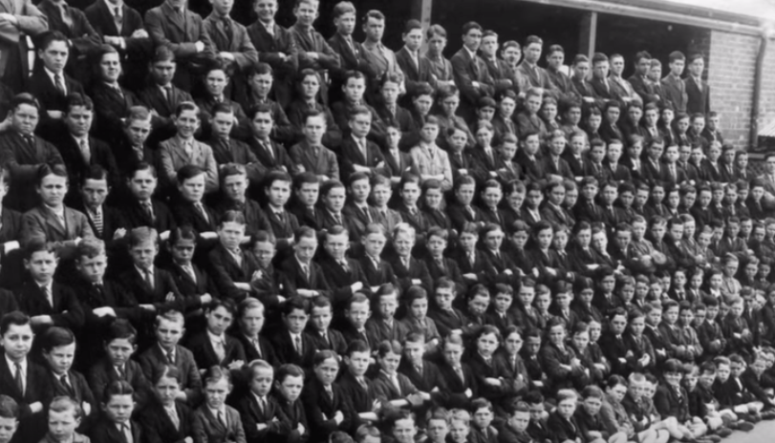
Notes:
Key points:
Here are some photos from the orphanages, along with a photo from the National Apology given in 2009 by then Prime Minister Kevin Rudd (top left).
Look at these large groups of children – especially the bottom right hand corner – can you imagine getting that many children to sit still, with almost all facing the camera! You can imagine the culture of fear and discipline that these children lived under.
Photos sometimes showed the children dressed in nice clothes, playing and smiling. But the reality was far from idyllic.
The nice clothes were generally only for Sundays, photos or when officials would visit – other times children might have taken from a communal clothing pile
The anniversary of the National Apology is in November – this can be a very significant day for some care leavers. You could consider making a note of the apology in your newsletter, maybe even holding a modest event to mark the anniversary – play the video and have morning tea. Make sure there is pastoral care. In the toolkit (to be discussed) there is a calendar of significant days

Slide 13
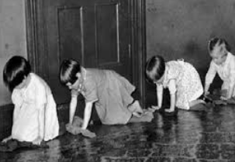
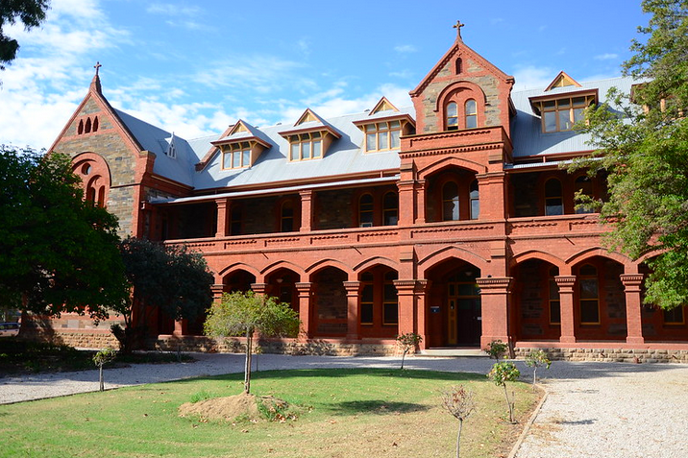
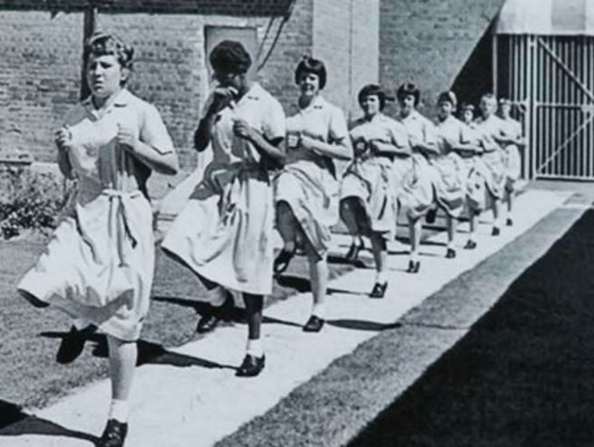
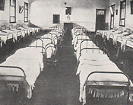
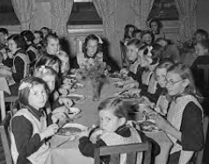
Notes:
Key points:
Photos of orphanage life – which demonstrate the lack of privacy that children had but also the foreboding and perceptions they many feel about aged care – in particular – residential aged care.
They had little choice and control over their lives – lived in dormatories with no personal possessions, very strict routines. Story – resident with dementia would strip her bed every morning, fold her sheets and blankets and put all her personal effects away into her cupboard. Return to orphanage life.
Communal dining rooms common - often forced to eat food they didn’t like or were allergic to, or that was spoiled or of terrible quality. Insufficient. You might notice residents with unusual behaviour around food – it could stem from a time when there wasn’t enough food for example
They were subject to harsh discipline, physical labour (other photos show older children holding sticks to beat the little ones with if they weren’t working hard enough), and regimented routines.
(Bottom right) Some aged care and other facilities are in the same location as previous orphanages – many names are still the same. The religious symbols can be triggering, as can the names of aged care homes where they have the same names as the Orphanages that Care Leavers were once in.
Even if you are in a newer building, if you have rooms, wings or anything named after the founding fathers or mothers, it is important to check as a number of those people have later been found to be perpetrators of physical or sexual abuse.

Slide 14
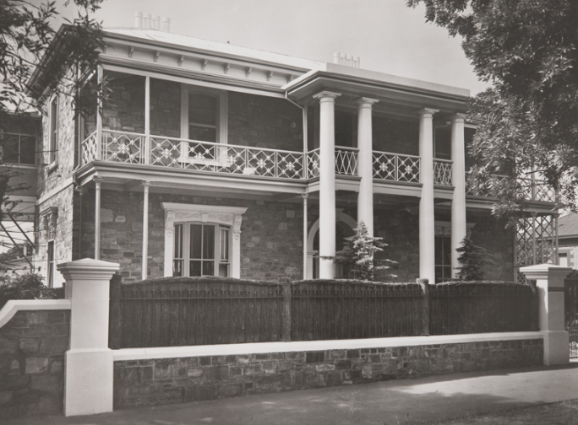
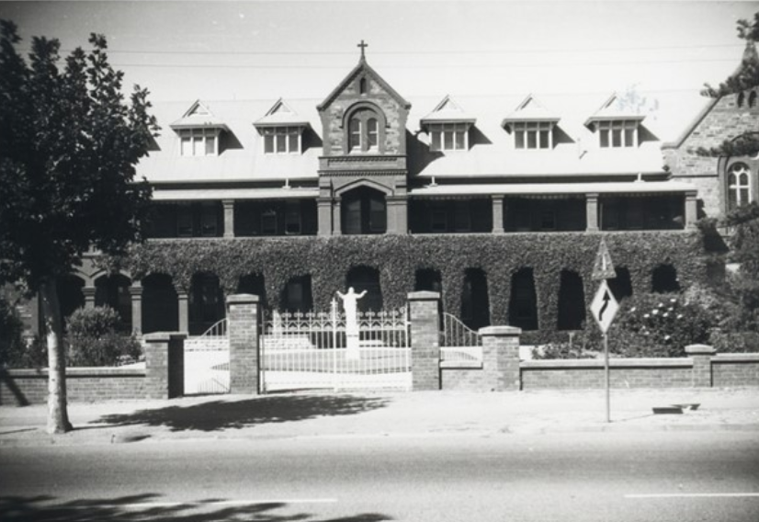
Goodwood Orphanage –
St Pauls, Gilberton
Kumanka Boys Hostel
Notes:
Note: In preparing a presentation, go to www.findandconnect.gov.au and locate photos of institutions in the local area – people may be familiar with the buildings and names. Many buildings still exist
Key points:
The Find and Connect website has details of the more than 800 institutions that existed across the country
Most children in care don’t have photographs from childhood
Something care leavers might like to do is have a look at the website to see if there are photos of the institution they were in. Sometimes they may see photos of people they knew.
Could be painful but also important and meaningful thing for them to do. They need to be supported.
Activity – group discussion:
Are there old homes around here?
Can people recall from when they were younger knowing about these homes or the kids who went there? Did you have an understanding of it?

Slide 15
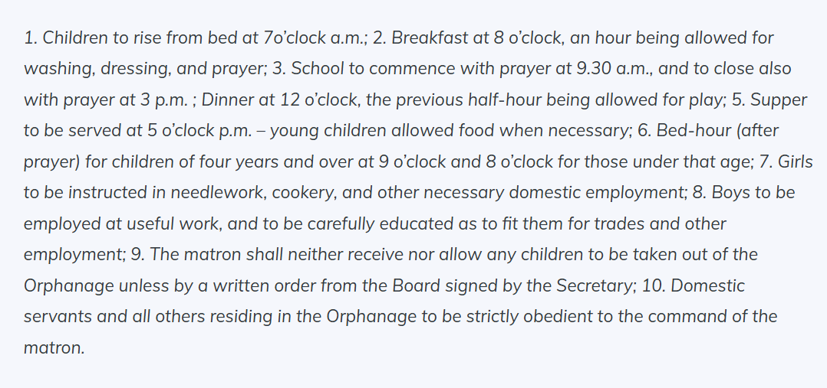

Slide 16
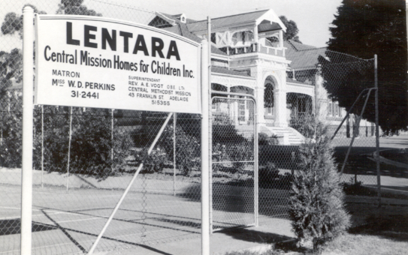
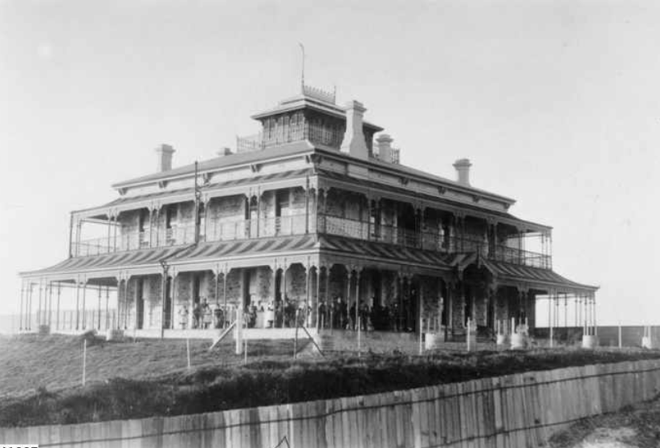
Estcourt House, Grange

Slide 17
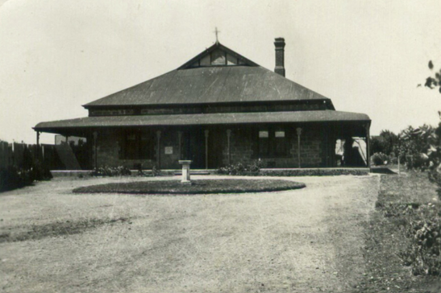
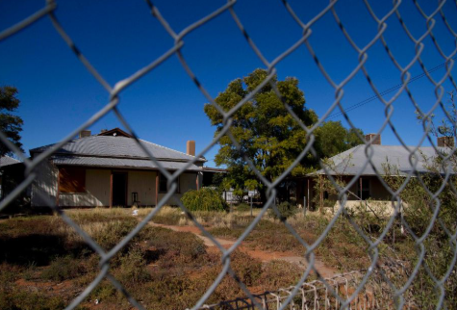
Umeerwarra Mission
Port Augusta

Slide 18
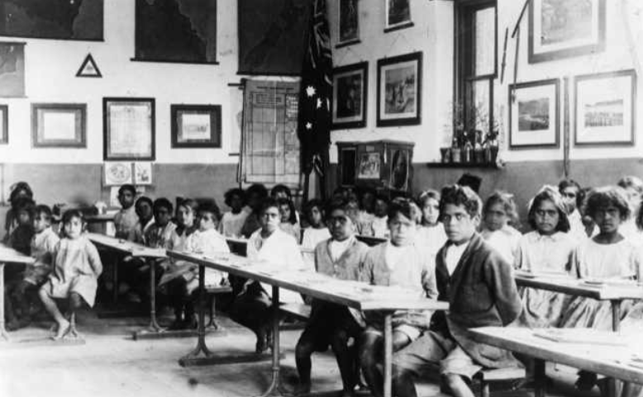
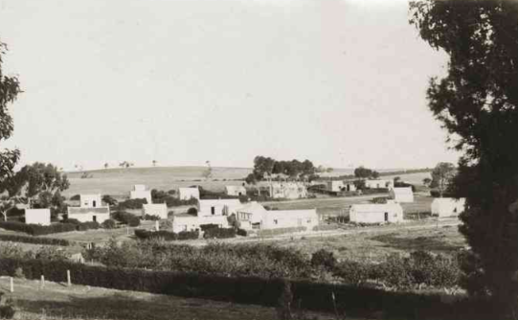

Slide 19
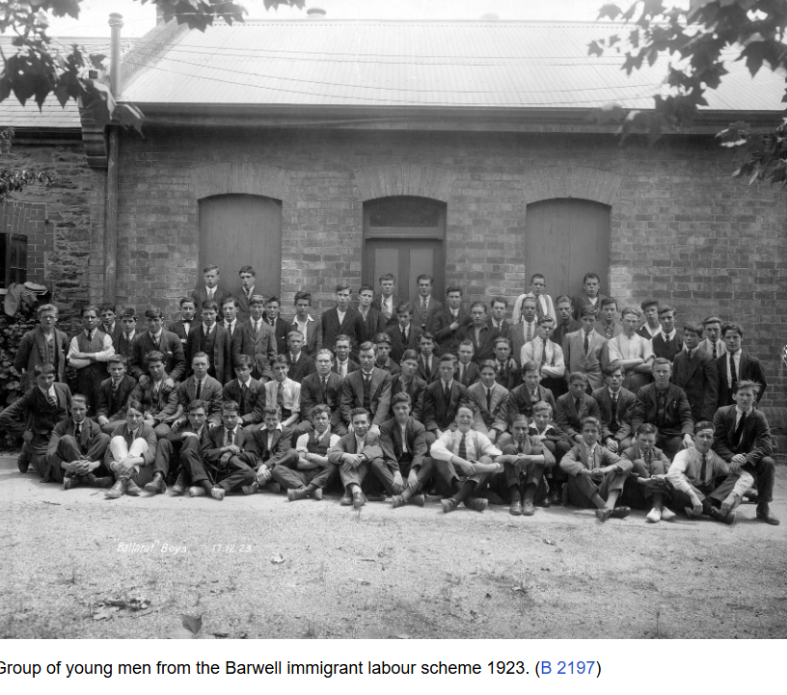
Child migrants
Barwell, SA
State Library SA
Notes:
Note: child migrants to Barwell Farm – 1920s

Slide 20
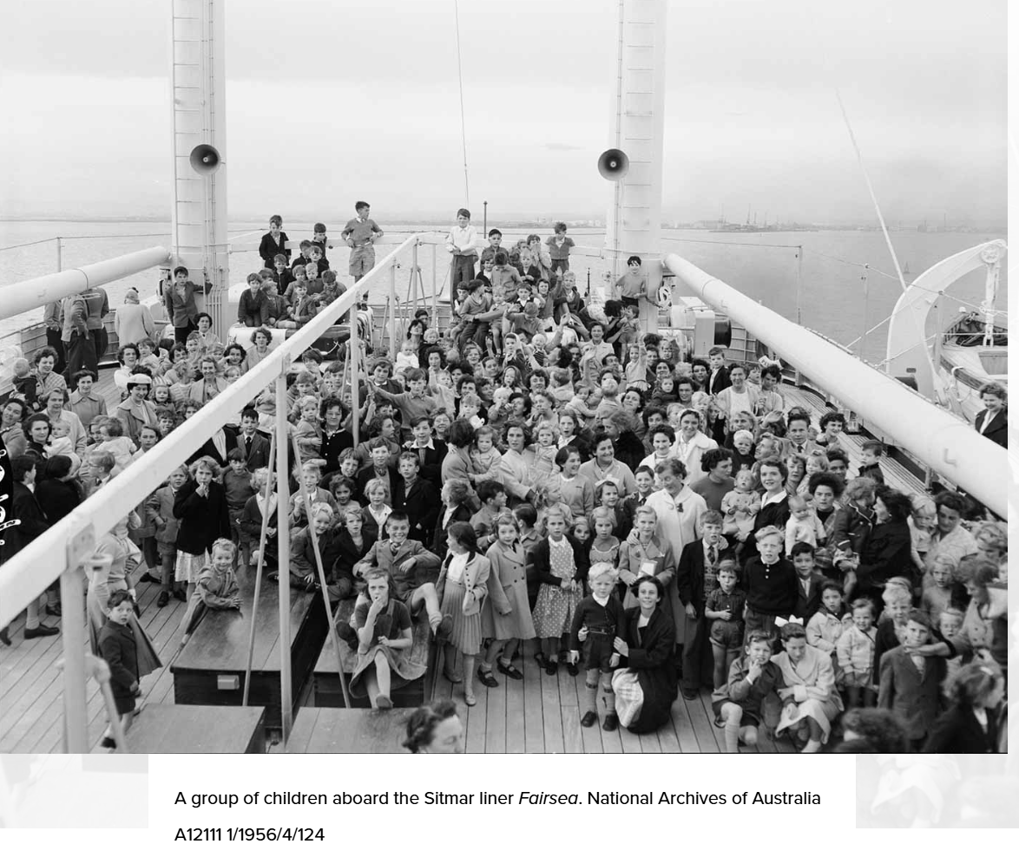
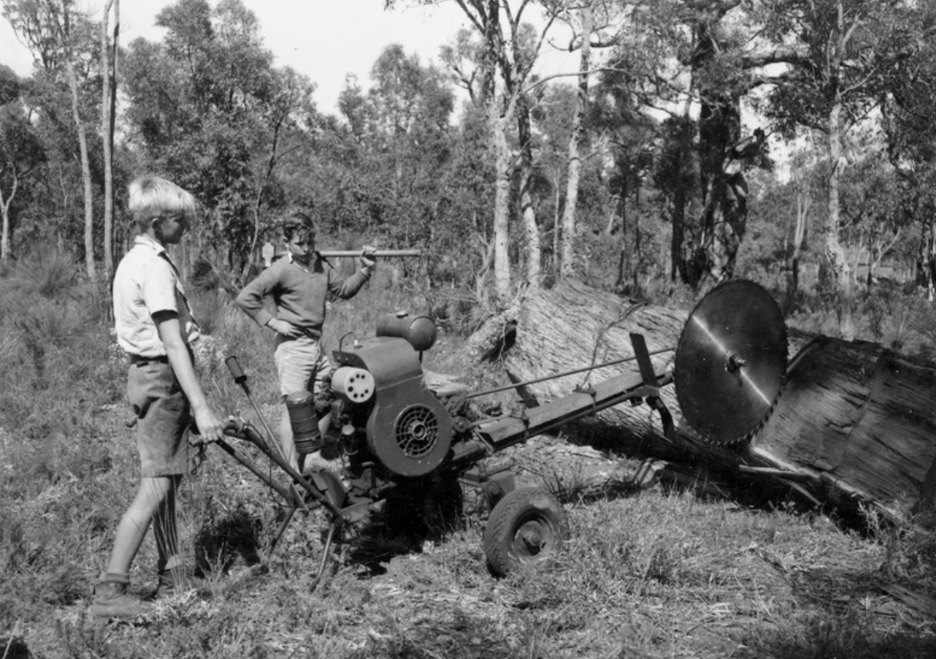
Child migrants
National apology to Forgotten Australians and former child migrants | National Museum of Australia
Notes:
Note: child migrants were settled across Australia many in WA; work photo from Fairbridge Farm WA

Slide 21
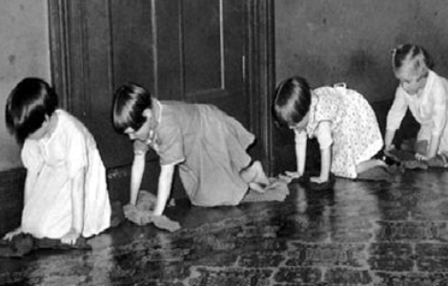
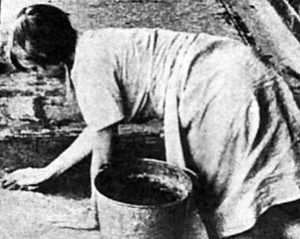
Experiences
Physical, emotional and/or sexual abuse by 'carers’ and/or peers
Loss of family, identity and culture
Neglect (love, food, education, safety, medical care)
Fear, anxiety, abandonment
No possessions – no names
Extreme physical hardship
Humiliating forms of punishment
Notes:
Key points:
Children in ‘care’ suffered all forms of abuse – sexualised and harsh environments
Some children never saw their parents again
Siblings were often separated by age and gender and never reconnected or not for many decades. Little babies may have been adopted and didn’t know they had siblings.
Many children lost their identity and culture – this is particularly relevant for our Stolen Generations and Former Child Migrants but also in the practice of calling children by numbers and not their names. They were often told they weren’t loved or wanted and would amount to nothing.
For many children who have spent time in institutions, their experiences were characterised by neglect, maltreatment, deprivation and loss of identity, making the transition into adulthood especially challenging.
Education only to late primary
Safety not prioritised – injury (cuts, broken bones), illness not seen to
No dental care (one toothbrush, 10 kids)
Harsh and humiliating punishments – bed wetting, physical beatings, sexual abuse as ‘punishment’

Slide 22
What are the barriers to accessing aged care?

Slide 23

Impact of experiences in care
Barriers to accessing support:
Aged Care unaware of group / trauma
Fear of re-institutionalization
Trusting – aversion to ‘authority’
Many left ‘care’ illiterate and innumerate
Lack of information about services
Dealing with conflict / solving problems /
communicating / making a commitment
PTSD (76%*) / anxiety / depression / health
Guilt and shame = non-disclosure / stigma
Intergenerational trauma including domestic violence
*Long Term Outcomes for Forgotten Australians (2017 UNSW)
Notes:
Key points:
Childhood trauma has consequences and lifelong impact. This includes acting as a barriers to accessing community services or aged care support – which is the reason the Real Care the Second Time Around Project exists.
Those barriers include: an aged care and health care sector who are largely unaware of the history and experiences of this group; a morbid fear of re-institutionalisation by Forgotten Australians/Care Leavers; a deep and longstanding aversion to authority – particularly Government and churches; and PTSD, anxiety, depression and other chronic and multiple comorbidities – and guilt and shame, fear of judgement experienced by many Forgotten Australians that has led to non-disclosure and of course compounds the trauma they feel.
Some care leavers can’t read or write and may lack the support networks to help them to navigate the complexity of the aged care system
Care leavers have often spent their whole lives with hypervigilance about their home and safety. People can be very reluctant to have workers come into their home to provide them with support. Delay in accessing community based care means that often, it reaches the point where acute care required.
Many forgotten Australians say they would rather die than go into residential care. And there are many who have made plans for that to happen.

Slide 24
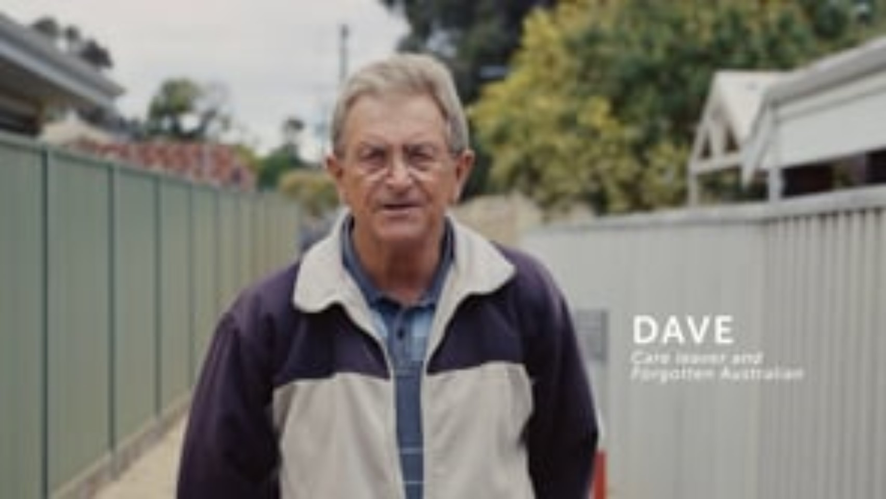
A project by The Big Anxiety - thebiganxiety.org.au
A film by Article One - articleone.com.au
(Filmed and edited by Steph Vajda)
2024 Creative Commons ND-A-NC
Notes:
I’d Rather Die – than be in aged care (17 mins)
Activity - After video plays:
Invite reflection, comments, questions – in small groups or together – what jumps out at you? Any surprises in that? Any call outs?
Some prompts :
Language – “inmates”, “prison”
Themes – loss of freedom, loneliness, vulnerability to abuse
Triggers – washing hair (instead of basin in room, go to hair salon and use chair)
Key points:
This film is made with the support of the Western Australian care leaver support service – Tuart Place. Each state and territory has a care leaver support service (name the local service) – details for each service are in the toolkit (to be discussed)
Care leaver support services have different services for care leavers – some do 1:1 counselling and support; peer support like drop ins, lunches, Christmas parties; redress support and aged care finders. Being around other care leavers can be very important. If you are working with a care leaver you can ask if they wanted to be connected with their local support service.
Reflection before break:
Would anyone like to offer any reflections at this point? Can you recognize what could be trauma behaviours in people you have worked with in the past or are currently working with?

Slide 25
What is the Real Care the Second Time Around project?

Slide 26
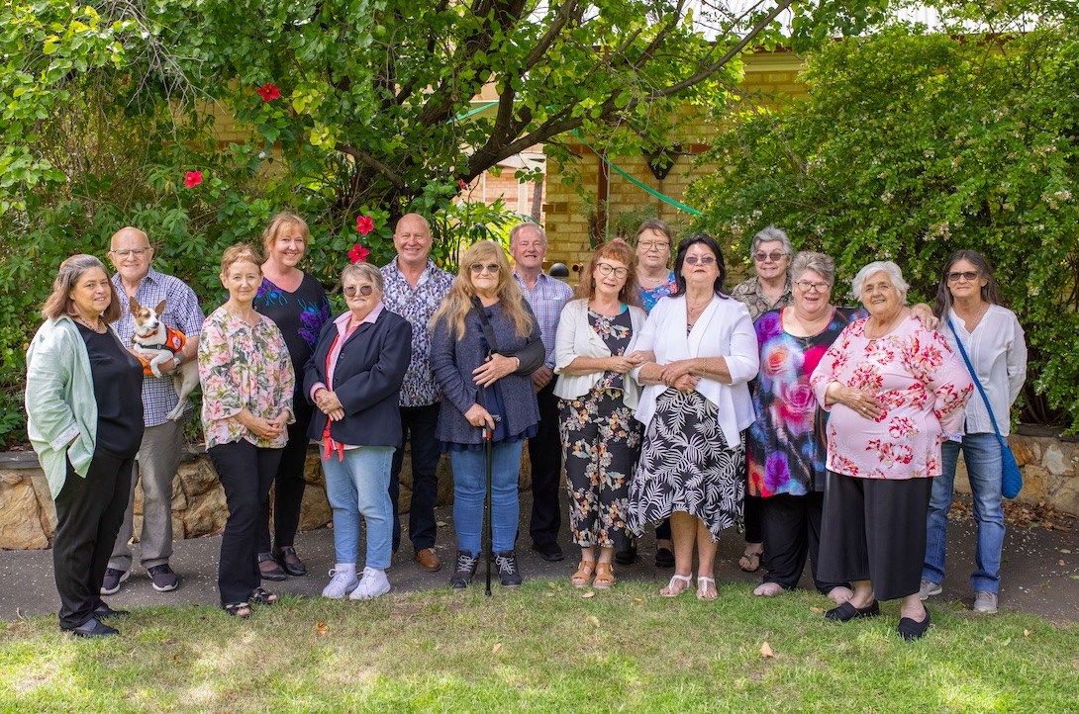
Real Care the Second Time Around Project
Commonwealth funded project
2019-2021 Pilot / 2022-2025 roll-out outcomes nationally
Partners: Flinders University, Relationships Australia South Australia (Elm Place)
Advisory Group
Co-design Expert Panel of ‘Forgotten Australians’
Notes:
Key points:
Helping Hand has codesigned a fantastic suite of resources to help us care for Care leavers
Real Care the Second Time Around is a Commonwealth funded project which commenced in 2019. Helping Hand Aged Care partnered with Flinders University and Relationships Australia South Australia and had a co-design expert panel of people who identify as Forgotten Australians.

Slide 27

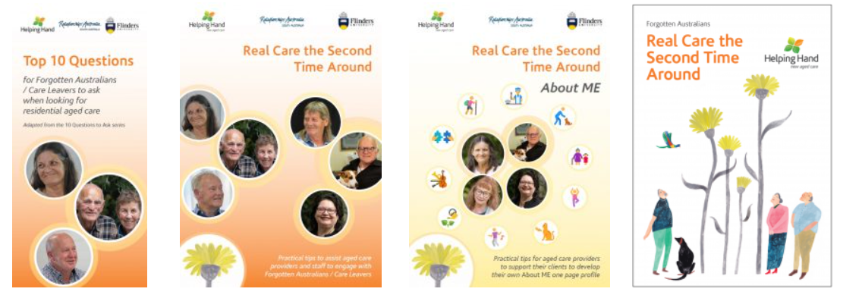
RCSTA resources
Online training module – 1 hours
Refresher training module – 20 mins
Debrief guide
Short scenario videos
Tips for service providers
Resources for Forgotten Australians and Care Leavers
Additional training module – confident conversations
https://www.helpinghand.org.au/about-us/diversity-inclusion/forgotten-australians/
Notes:
Key points:
The following resources have been developed and are all available free on the Helping Hand website and in the toolkit.
The online training modules can be provided as SCORM packages for your own LMS
Additional short refresher module in development
(Where hard copies are available point people to them)

Slide 28
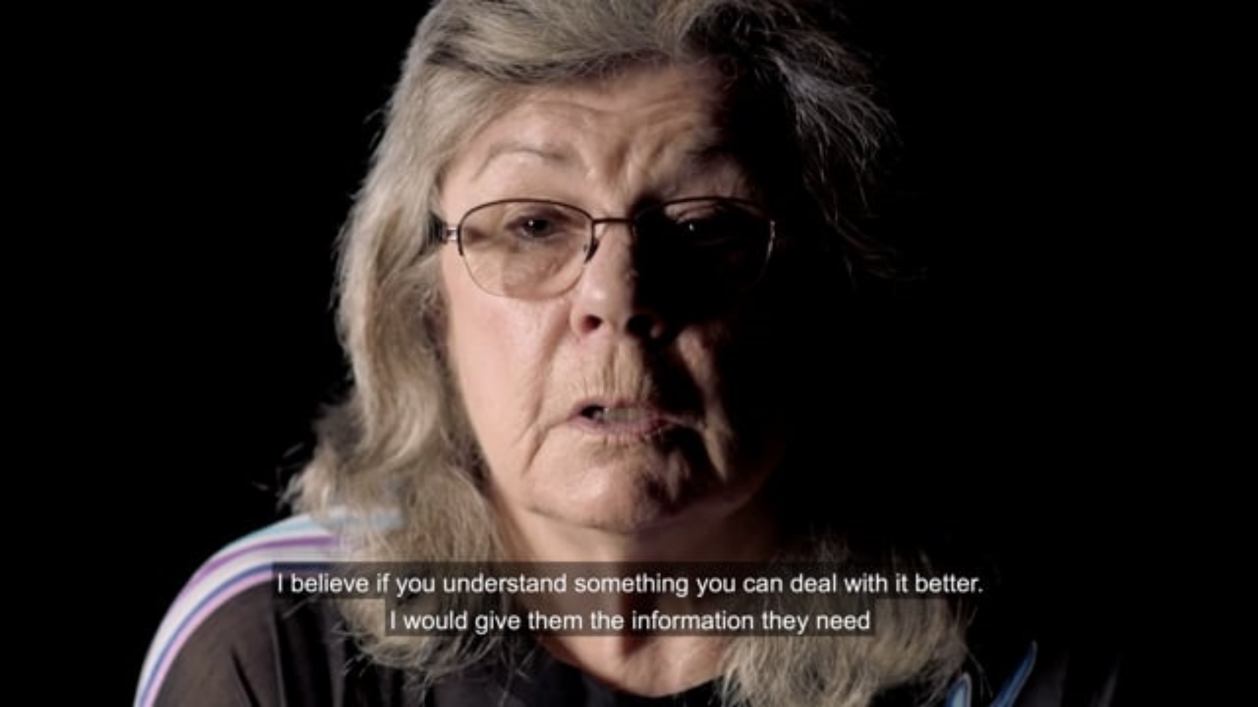
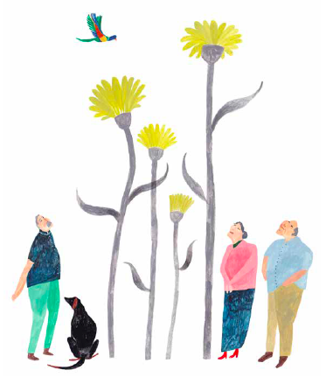
Session 2
https://vimeo.com/612293547/4ddff50f9e
Notes:
Activity:
Watch this 5 minute video which is one of the RCSTA resources
Group discussion:
Invite reflection/comment/questions
Prompts:
‘we don’t always learn the best ways to behave’: think about pain/trauma based (rather than ‘challenging’ behaviors or ‘non-compliance’, lack of trust, difficulty solving problems or dealing with conflict…
‘leave your judgements at home’ – we all bring our own lens; there may be reasons people behave the way they do that we can’t understand eg smoking – calming, some children in care given cigarettes as favours to sexual abuse or to keep them quiet
‘I don’t want to be put into a box for Forgotten Australians’ – importance of recognizing individuals; avoid making assumptions; see people as humans not tasks
‘I feel afraid being isolated with a male’ – don’t assume, ask
‘I would need to be asked if I had any complaints’ – children in care were not allowed to complain, we need to create warm environments where people can tell us something is wrong
‘I would need to be asked if I feel safe’ – we can just ask – are you comfortable? Is there anything we can do? Explore concerns in intake and lifestyle and keep checking in

Slide 29
Session 2
What does Trauma Informed Aged Care look like?
Notes:
Key point:
So what does it actually look like to provide trauma aware, healing informed care?

Slide 30
6 trauma informed care principles
Safety – emotional as well as physical e.g. is the environment welcoming?
Trust – is the service sensitive to people’s needs?
Choice – do you provide opportunity for choice?
Collaboration – do you communicate a sense of ‘doing with’ rather than ‘doing to’?
Empowerment – is empowering people a key focus?
Respect for Diversity – do you respect diversity in all its forms?
Notes:
Key points:
These principles apply not just to care leavers and not just to aged care – they can be useful in a lot of areas of our lives
Copied from What is trauma-informed care? – NSW Health

Slide 31
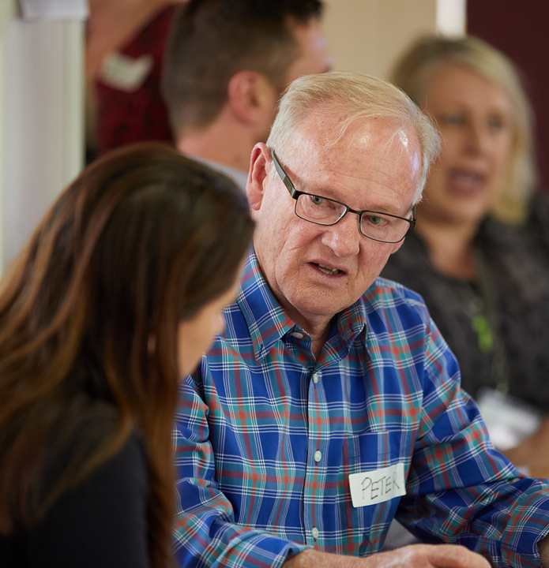
Achieving safe and inclusive care
Establish trust and safety
Providing peer support
Sharing power - collaboration
Respecting personal space
Choice and voice
Flexible service delivery
Respecting diversity
Understand impact of trauma
Understand history and experiences
Identify Forgotten Australians at intake / assessment
Notes:
Key points:
We can think about how these principles apply to anyone we are working with in aged care – community or residential
A key component to establishing trust is following through – do what you say you are going to do
Give people the information they need to make decisions for themselves
Treat everyone as an individual and as an adult
Understand there can be complexities – unusual behaviours, overlays of trauma, lifelong impacts
Meet people where they are – without judgement

Slide 32
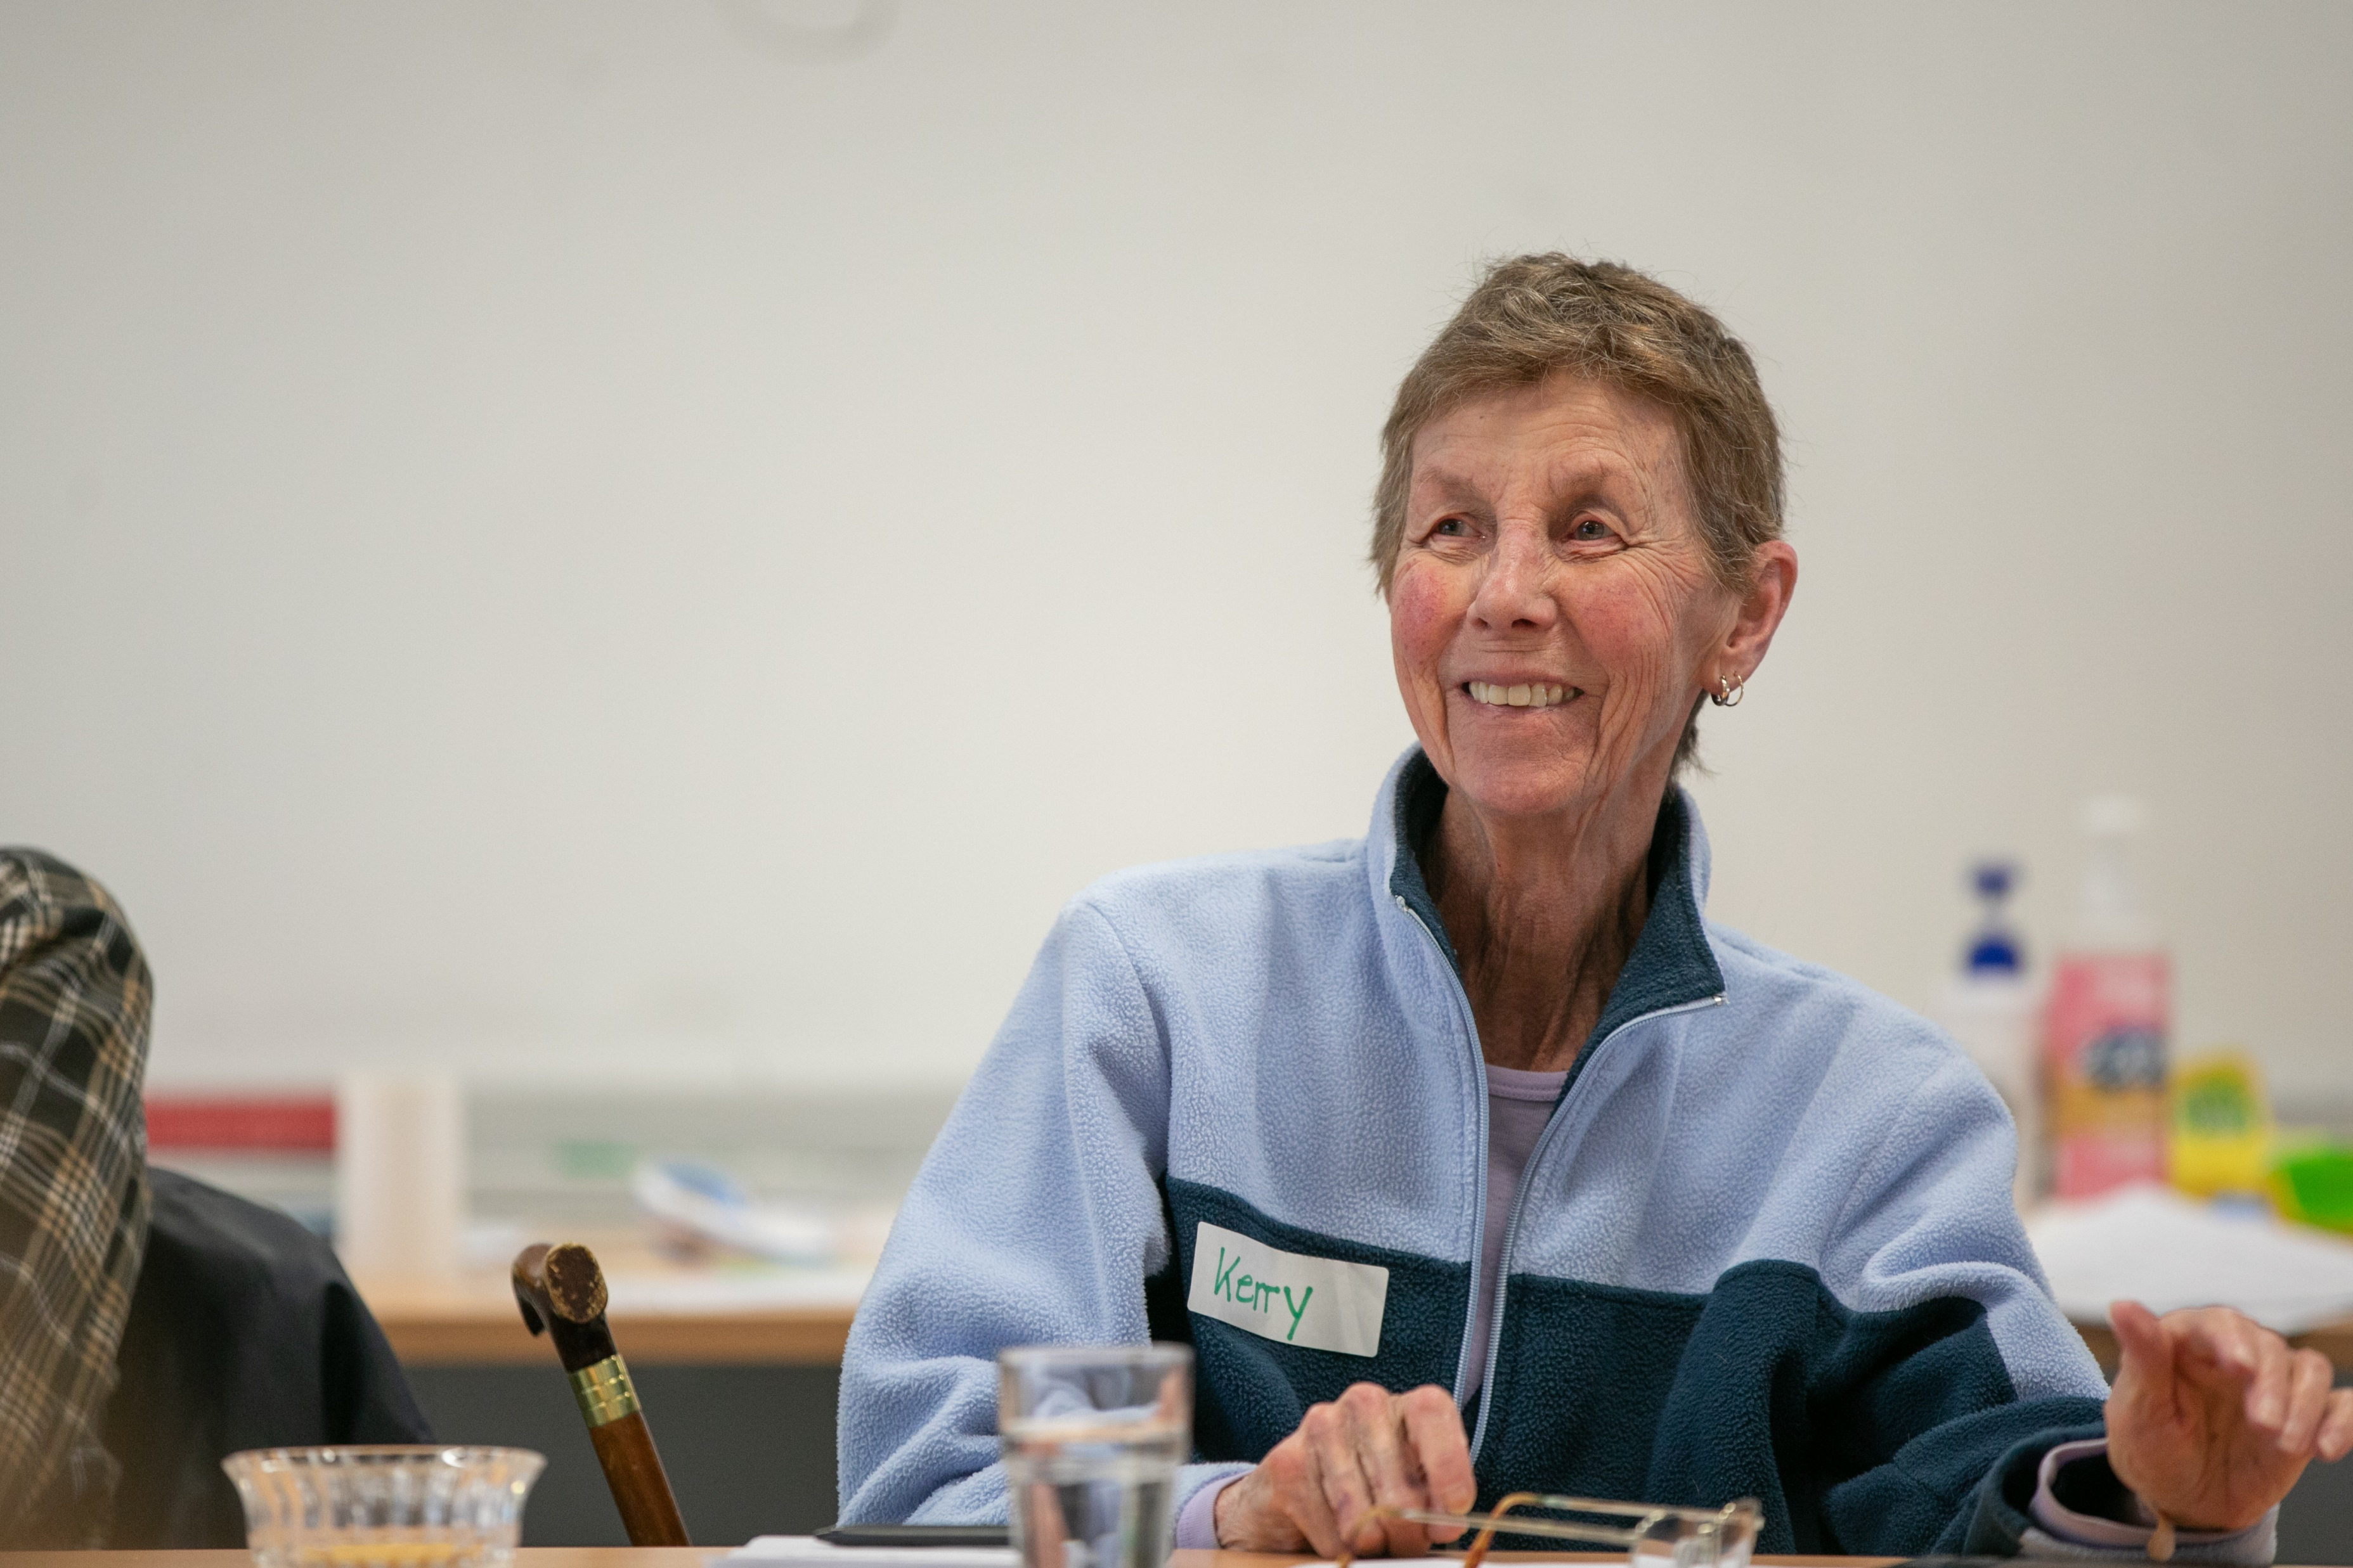
Practical tips
Use people’s names – not ‘love’ or ‘dear’
Provide consistent care team as much as possible
Keep clients/residents advised if something needs to changes in their care
Provide options for what and where to eat
Ask for gender preferences in the provision of care, especially personal care
Notes:
Key points:
Here are some things you can do immediately that will move you towards the provision of trauma informed care for Forgotten Australians and careleavers
Pick a few dot points to call out
Names are very important – preferred names
People know things have to change sometimes – tell them ahead of time, surprises undermine trust
Ask people their preferences
As you can see, these things are very simple and relatively easy to achieve with simple awareness raising among staff

Slide 33
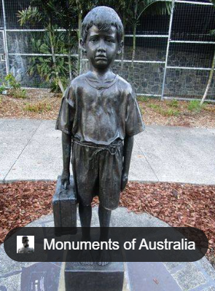
Practical tips
Recognise aggressive behaviour as possibly being linked to trauma
Don’t move people’s possessions around unnecessarily
Respect privacy and preferences – doors open/closed, knocking
Give choice as much as possible – eg shower times, mealtimes
Provide alternatives to participation in group activities including, for example, Christmas or Mothers’ Day which can be triggering
Care leaver memorial - Brisbane
Notes:
Key points:
Aggressive behaviour could be trauma based or pain based – be mindful of language, take the time to step back from the behaviour and think about what might be going on
Story: resident in memory support unit deeply distressed and protested showering. Considered possibility of sexual trauma in the past. Used a hairdressing cape during shower time.
Story: first nations resident in memory support who was scratching all night in bed. Thought there were bed bugs. Now bring clean fresh sheets and make the bed with her.
Important not to force people to participate in community activities – eg Mother’s Day, Christmas Day can be triggering. Be mindful of Christian Christmas carols and symbols.
People (not just care leavers) may have other days they want to mark – we can ask everyone. For a care leaver, it could be the day they left care, the day they turned 18
As you can see, these things are very simple and relatively easy to achieve with simple awareness raising among staff

Slide 34
Stolen Generations
  From 2023, all Stolen Generations survivors are aged 50 or over
  Common triggers:
  Clinical settings
  Tone of voice/authority
  Facial expressions and gestures
  Any situation that brings back feelings of the lack of control
  Singing of Christian songs
  Being bathed
  Keys jangling, loud sudden noises
Notes:
Key points:
For First Nations people, there can be additional traumas from colonisation and removal, experiences of racism and structural inequality
Healing Foundation resources are available to educate those caring for elders
Here are some of the issues discussed in those resources

Slide 35
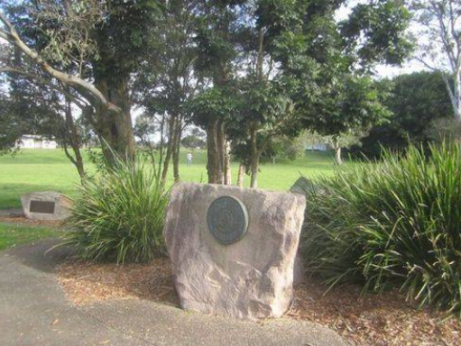
For Stolen Generations
Next of kin – community connection
Connection to country
Discrimination and racism
Touch/personal care
Gender/taboo issues
High standards of cleanliness and appearance
Lack of documentation – concerns about things being written down about them
Stolen Generation plaque
Kalinga Park, Brisbane
Notes:
Key points:
There are additional factors that we should consider in caring for First Nations people for example
Concepts of family may be different to other cultural groups
Connection to country is about more than a geographical connection – it can be spiritual
People’s experience of discrimination and racism throughout their lives can impact in a myriad of ways
People may be highly sensitive and distressed at receiving personal care due to experiences of abuse, along with issues about gender and taboo subjects
People may have high standards of cleanliness or presentation of their own appearance and be very distressed if these standards aren’t met
Deep mistrust which means people aren’t comfortable when things are being written down about them
People may lack documentation eg birth certificates

Slide 36
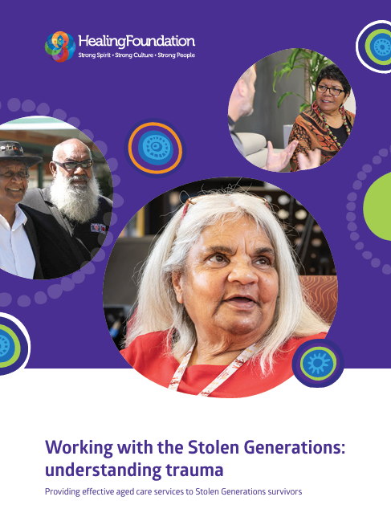
For Stolen Generations
Consider healing opportunities eg art (in consultation with survivors); outdoor spaces
Cultural and kinship details considered in care planning – eg important people, significant dates
Support contact with community
Partnerships with trusted organanisations
Support people to know about their rights and how to raise issues
Support cultural safety and call out racism
Support Indigenous staff
Working-with-Stolen-Generations-Aged-Care-fact-sheet.pdf (healingfoundation.org.au)
Notes:
Key points:
For all care leavers – or all residents and clients really – but especially for first nations people we should think outside the box, or outside of our own lens
Here are some examples

Slide 37
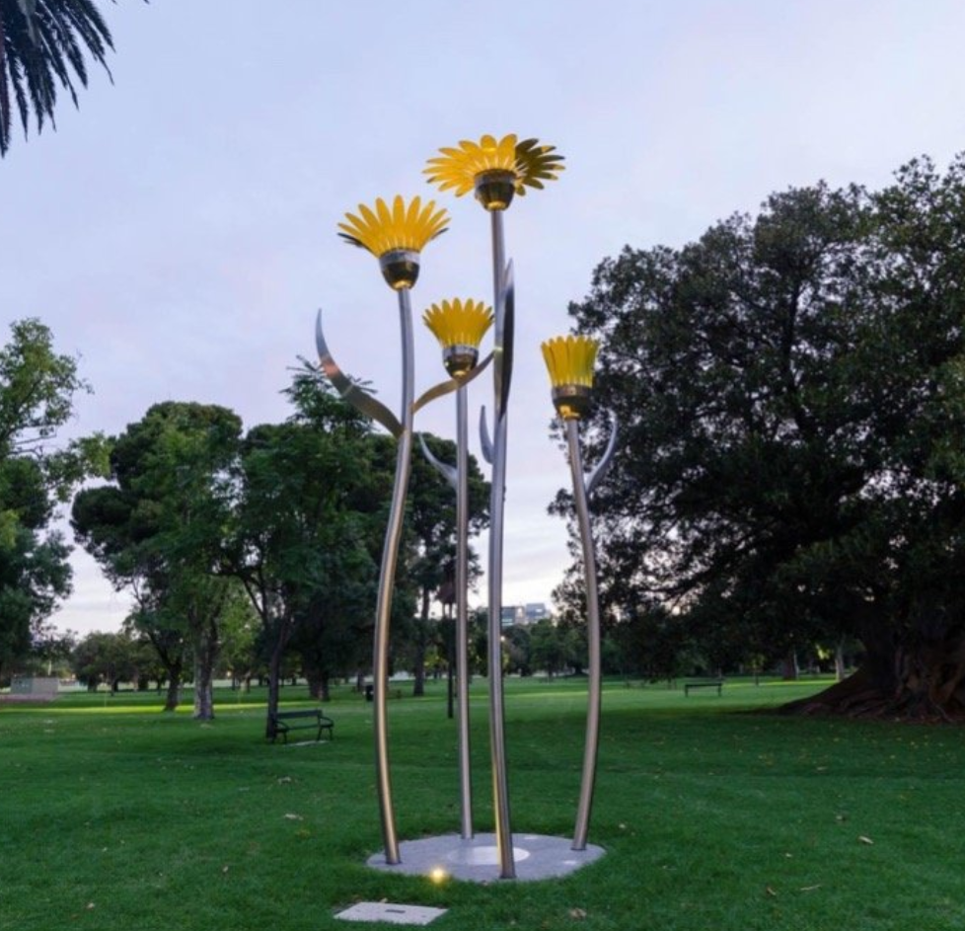
Case studies/examples from your own experience
Notes:
Activity: group discussion
Do you have case studies or examples from your own experiences with clients and residents?
(Photo is Forgotten Australians memorial)

Slide 38
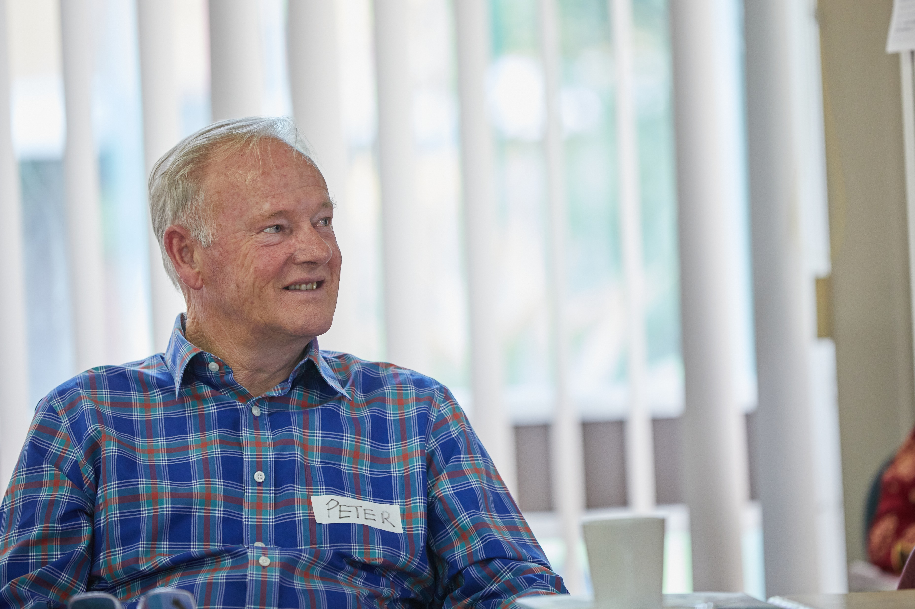
Specialisation verification
care leaver on staff/champion
connection to care leaver support service
90% staff trained
physical environment
care leaver on governance body
active care leaver advisory group
policies and procedures
care leaver residents feel supported
Notes:
Key points:
To tell you a little about the specialisation verification process. There are currently verification processes particular groups, known as special needs groups under the old Act
For careleavers, providers must be able to demonstrate 4 out of 8 criteria
Here are the 8 criteria – there needs to be certain documentation as evidence that the criteria is being met and the toolkit supports this with templates and tools, for example:
there is a PD template for the champion
template MOU with care leaver support services
of course the training modules
a policy on trauma informed care
physical environment checklist
terms of reference for a governance body or advisory group
All staff are encouraged to support moves to embed practice and so that verification can be sought

Slide 39
Bringing trauma aware, healing informed care to life
Notes:
Key points:
Of course, training staff is critical to embedding this work
However, there needs to be focused activity to really bringing it to life
The resources provide a number of ways to do that
We will do some of the activities now

Slide 40
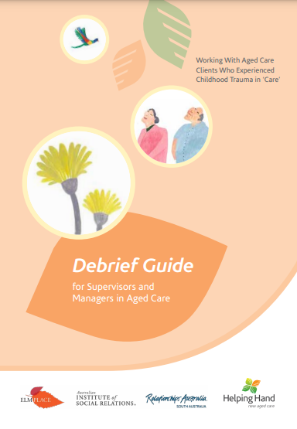
Training debriefing
Champions and team leaders
1:1 or in teams
1 hour
Support practice and reflection
Capture practice/actions/outcomes
Notes:
Key points:
There is a detailed debriefing guide available which can be utilised 1;1 or in teams
But we know that everyone is so pushed for time…

Slide 41
Teams discussions
12 month program of team talks
11 x 10 min activities – can be delivered in any order
Can be led by team leader or rotate lead amongst staff
Builds on existing resources
Notes:
Key points:
…So in the toolkit there is a we have developed a shorter program of ‘team talks’ activities

Slide 42
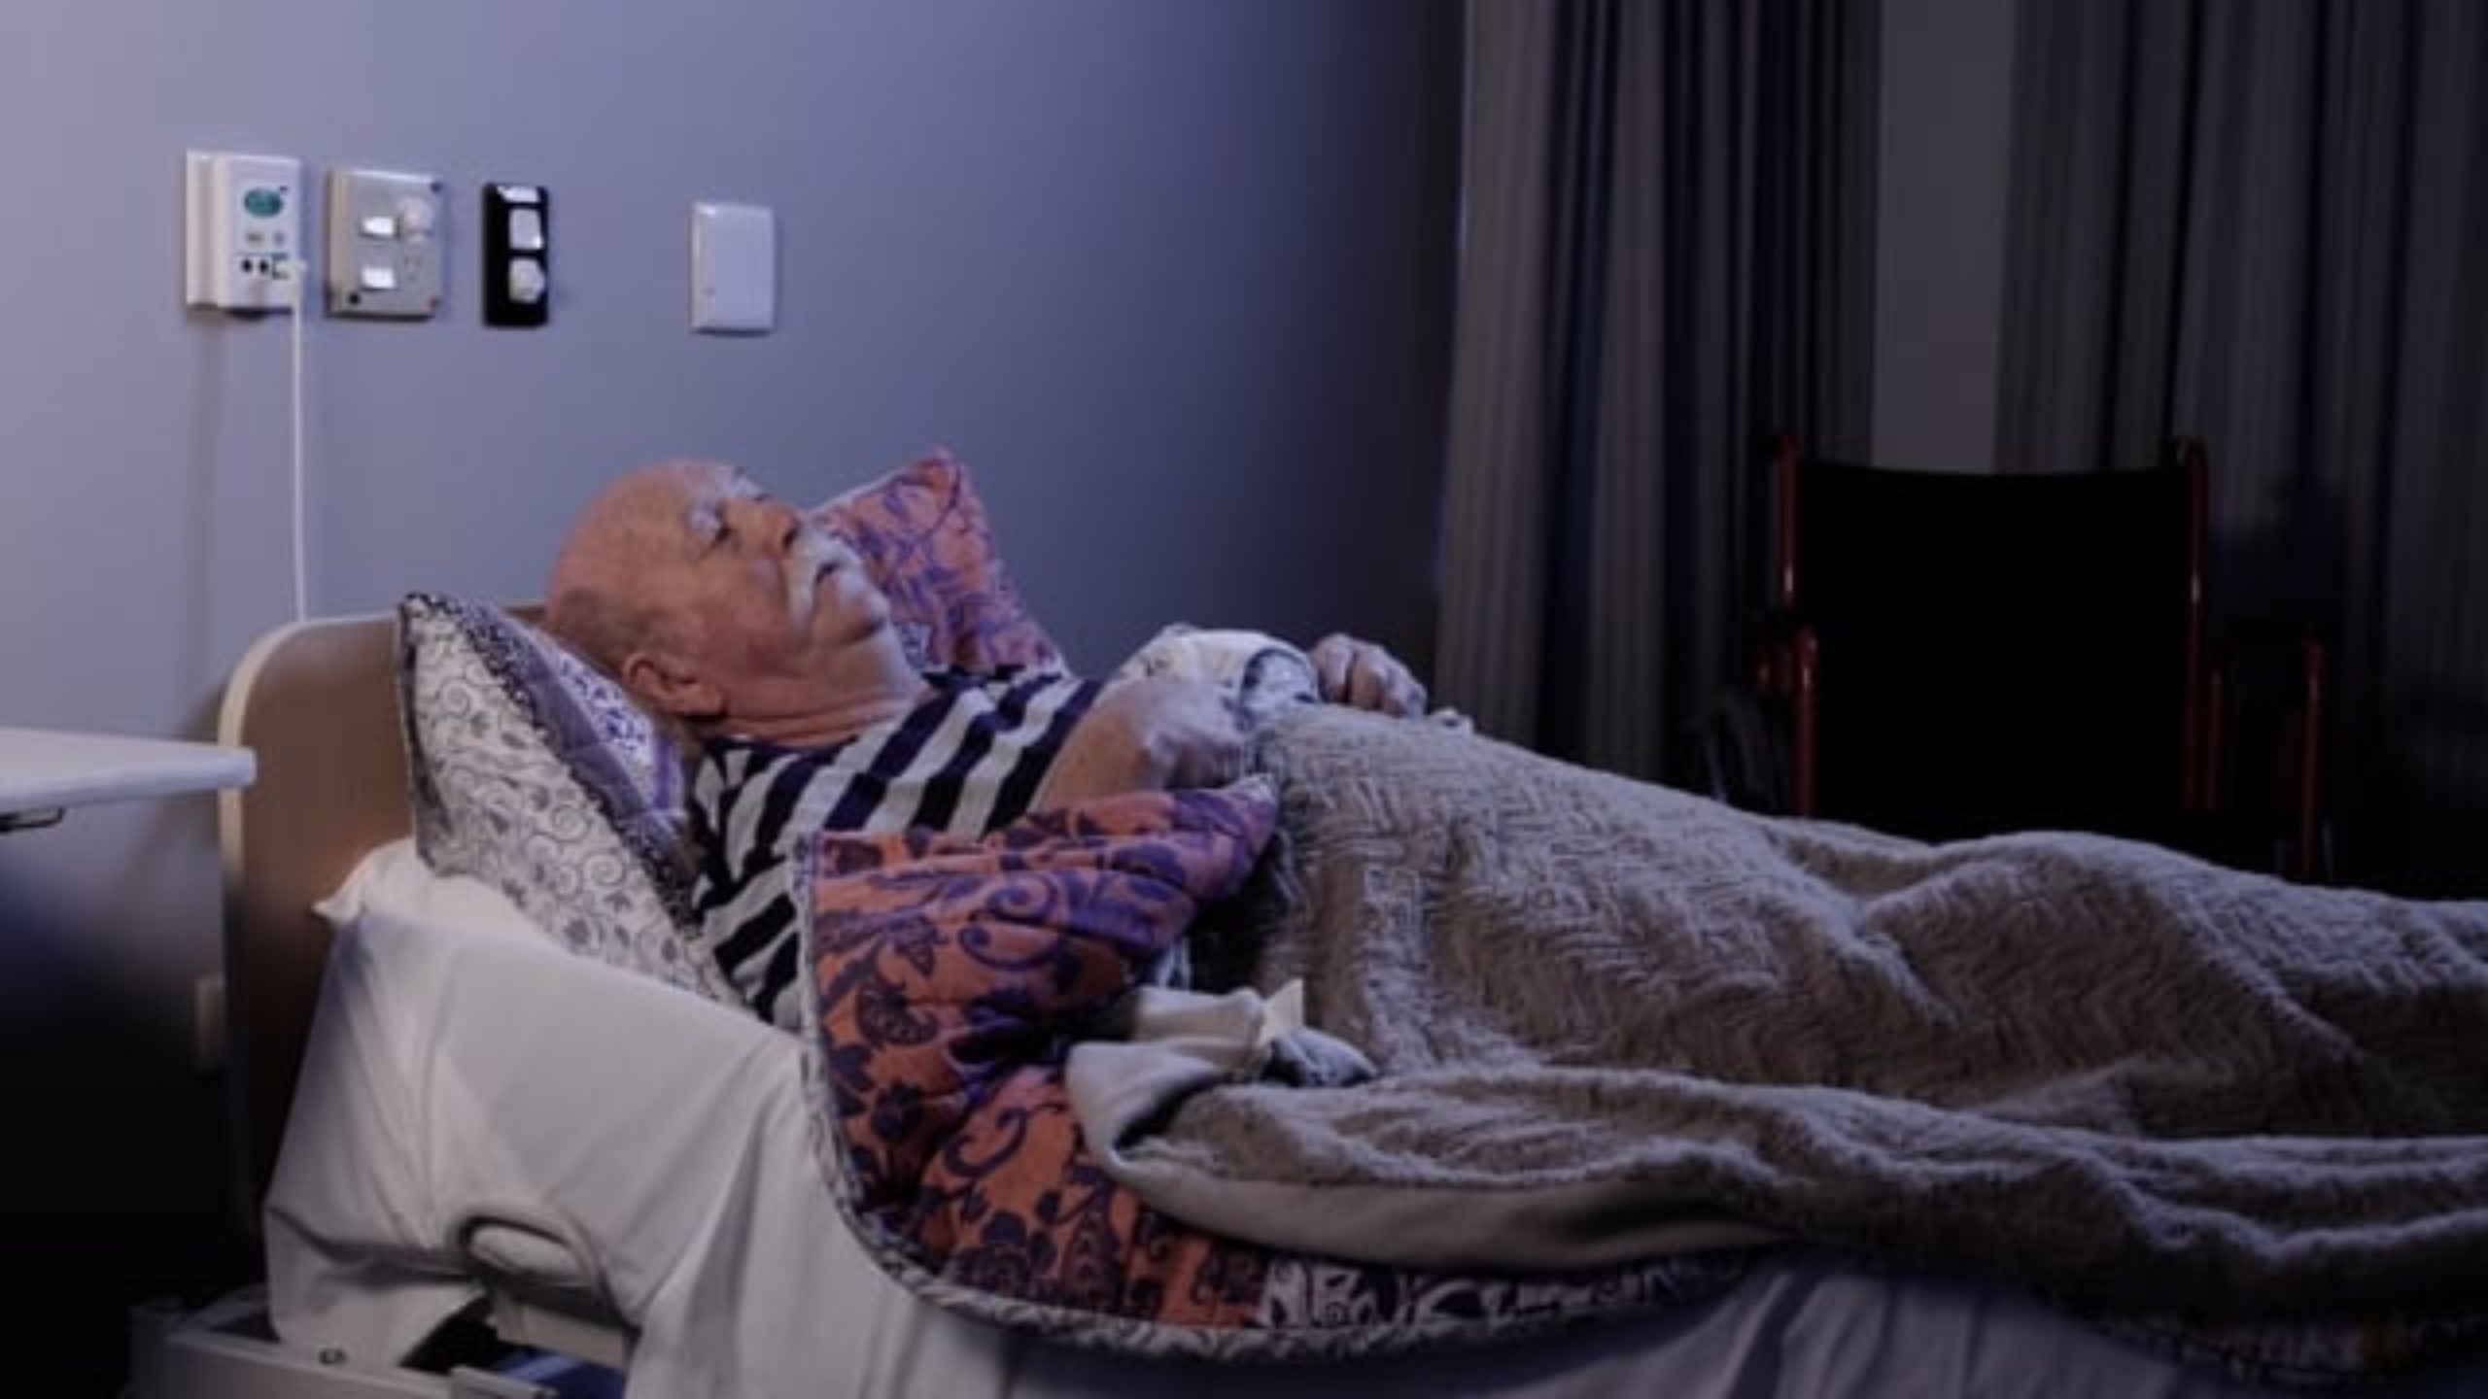
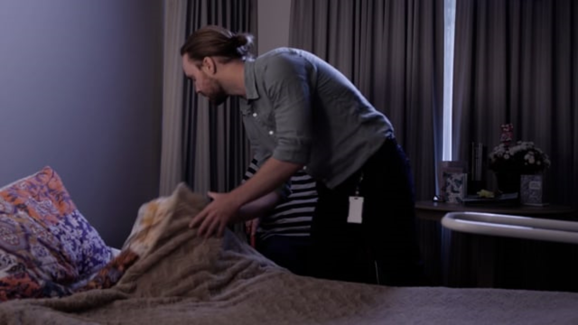
Team toolbox talk activities
Bed time scenarios
What is wrong and what you would do here that is different?
What is better about this and could you improve on it further?
Notes:
Activity:
Play each video (the videos are in the online resources)
Group discussion on the questions
Problems:
Didn’t introduce himself
Appeared in a rush, not warm and friendly
Didn’t give the resident choice about bed time
Didn’t ask his preferences
Other things - Didn’t give him call bell; Didn’t ask if he needed anything; bathroom
Prompts:
Does it look like scenario two every time in our service?
Are we sure?
Are we kidding ourselves to think that (at least sometimes) staff don’t get task focused?
The second video is 11 seconds longer than the first – and it would take much longer than that to return and settle the distressed resident in the first scenario

Slide 43
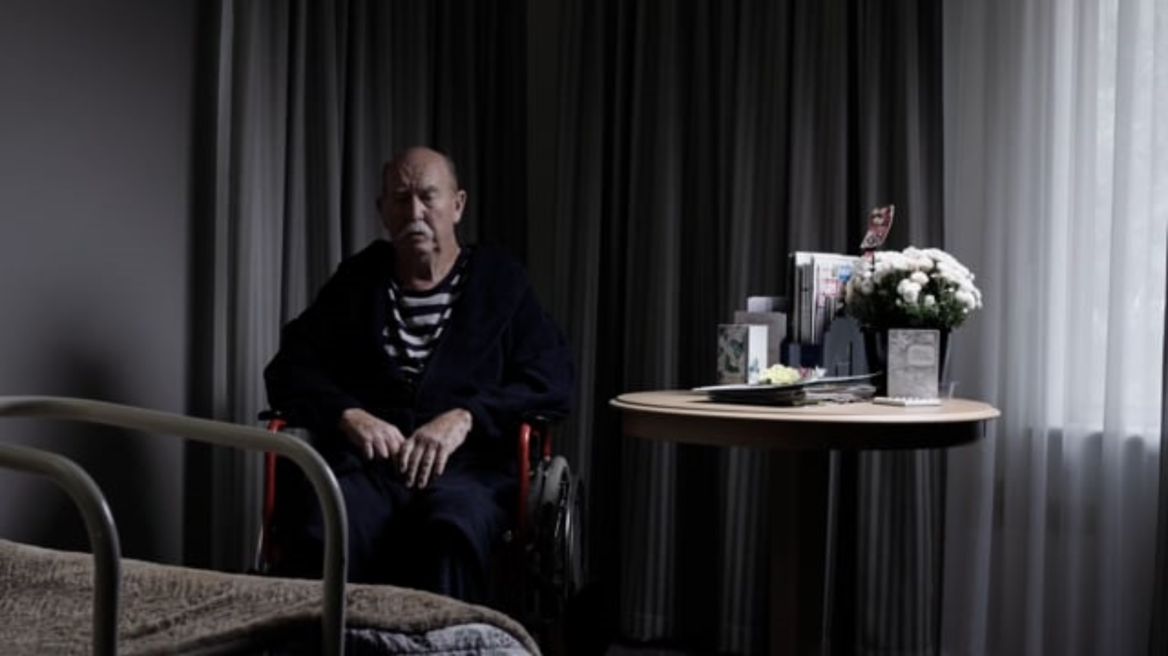
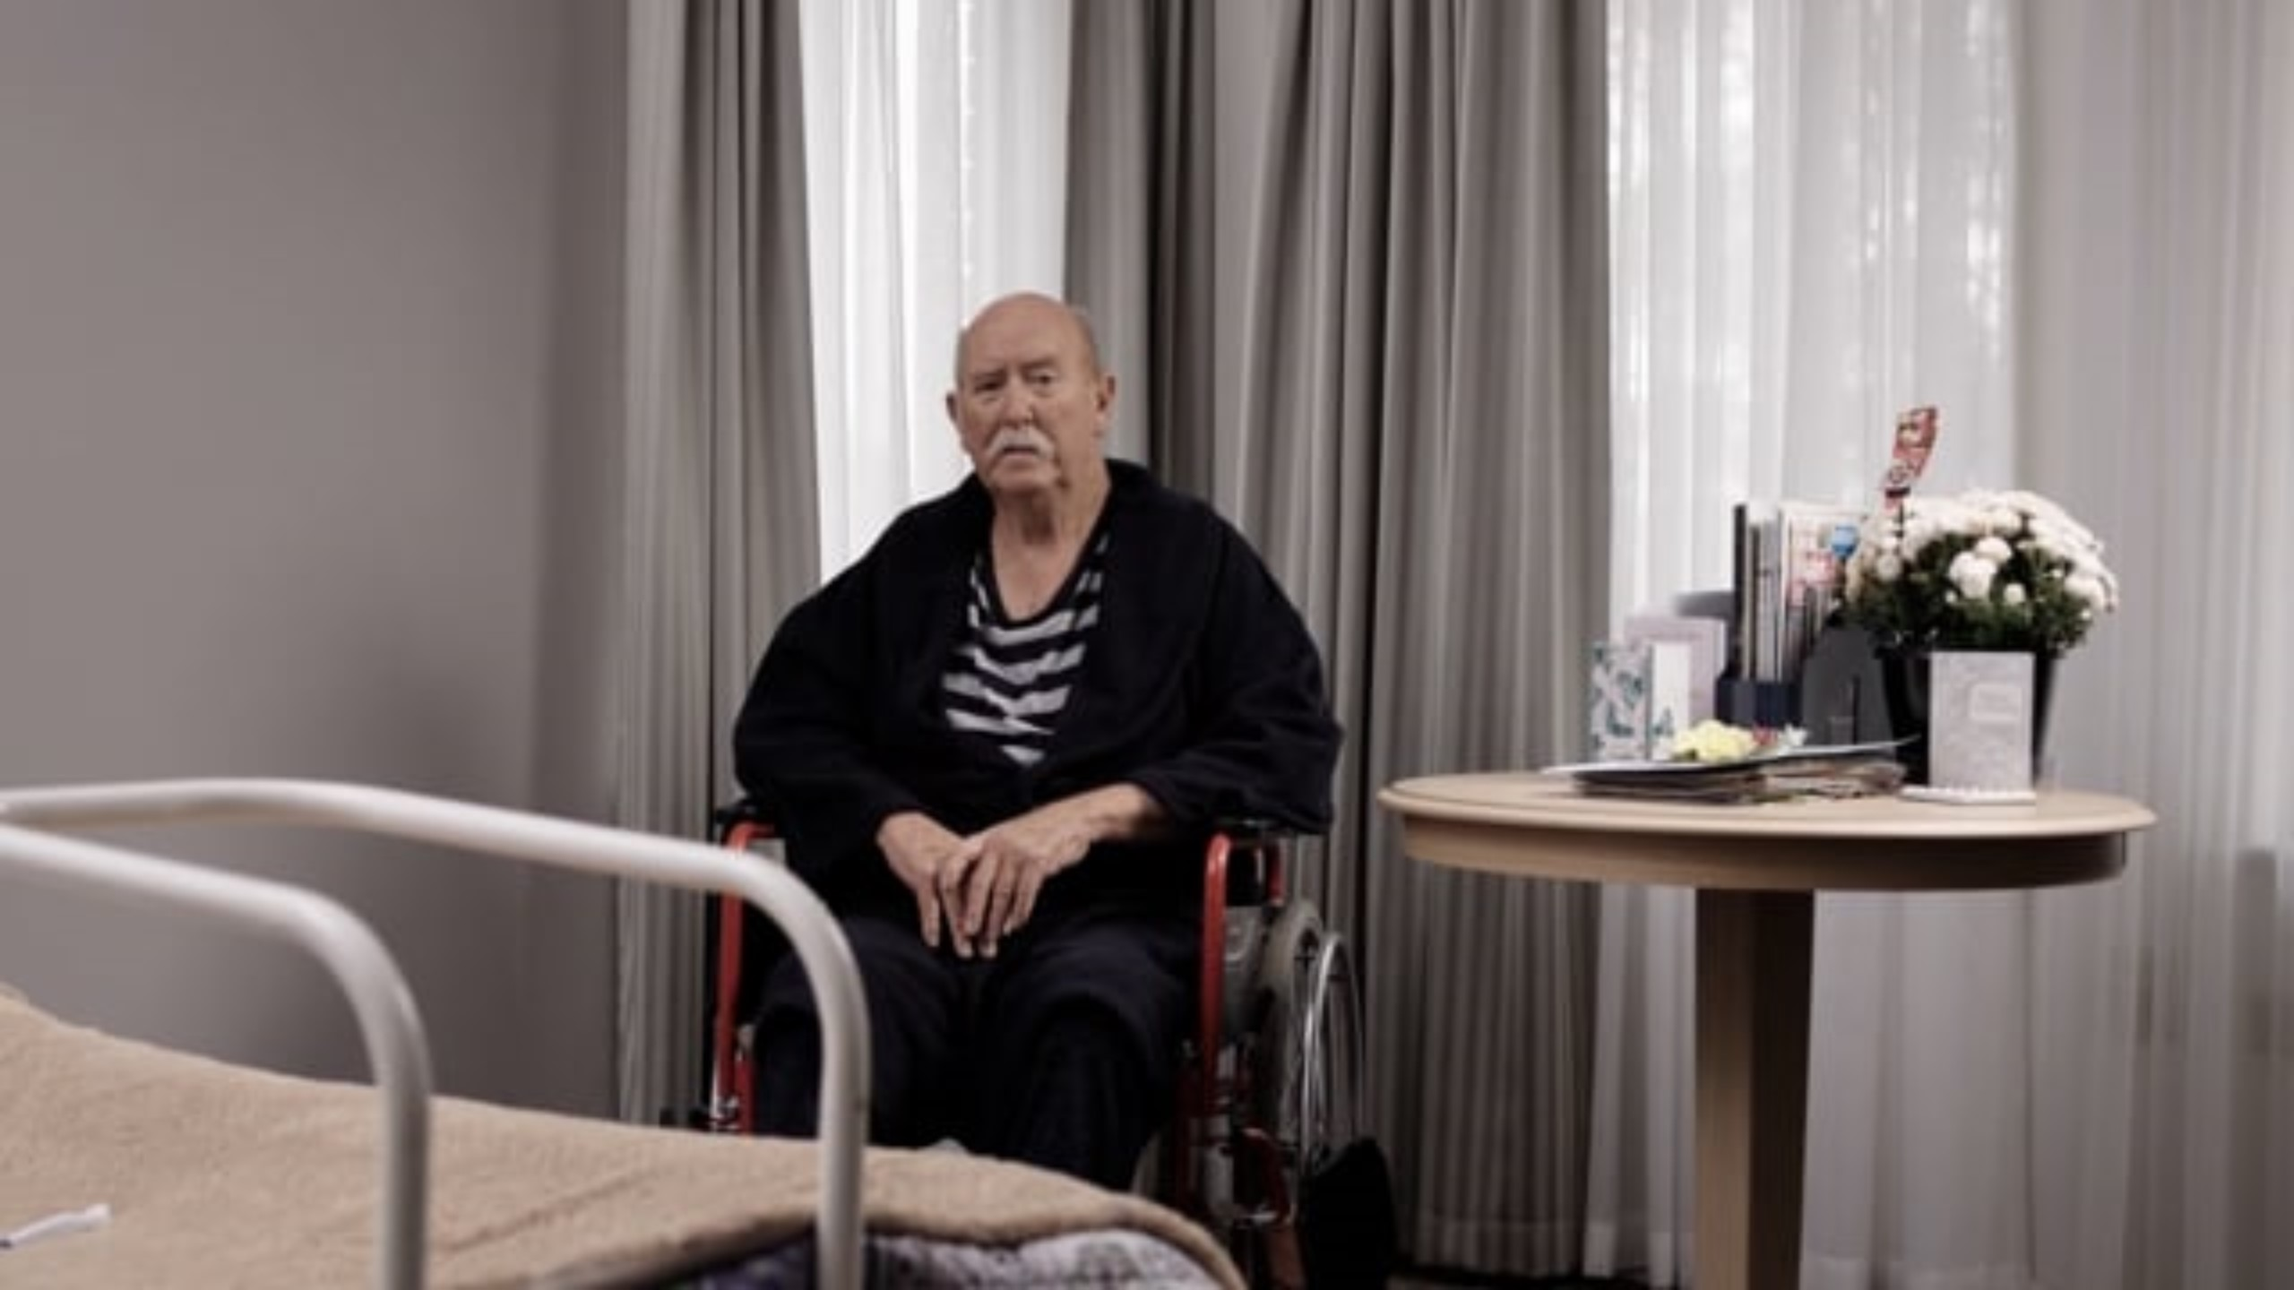
Team toolbox talk activities
Shower scenarios
What is wrong and what you would do here that is different?
What is better about this and could you improve on it further?
Notes:
Activity:
Play each video (the videos are in the online resources)
Group discussion on the questions
As per previous slide
So you can do these quick activities with your team

Slide 44
Team toolbox talk activities
Questions that care leavers might ask
Notes:
Activity:
Note: ugly slide to follow – but these questions are in the debrief guide

Slide 45
Will you ensure that I am always called by my preferred name and not a term of endearment (for example, darling, love)?
What are the rules and regulations here?
Do you and your staff know about Forgotten Australians / Care Leavers?
How will you ensure that no one touches me unless I give permission?
Can I have my pets here?
I feel trapped very easily – can I go outside anytime, including night time, and leave a window or door open?
How do I complain if a worker is rude? Will you believe me?
Will you have time to listen to me when I speak?
Do you have at least one Forgotten Australian / Care Leaver on your Board of Management?
How will you let your staff know my story so that I do not have to tell it again?
Do I have an opportunity to share my story so that you include my likes and dislikes in my support plan?
Can I choose a female/male support worker?
Do residents have their own rooms here? Does the room have a window/door that I can open and close? Does it lock?
Have staff been trained in Silver Rainbow Training? Do you have Rainbow Tick Accreditation?
My interests may be different to other people. Will you still support me to do an activity when no one is interested?
Do you lock rooms here?
I don’t want people coming into my room unannounced. Can I lock my room door?
Do I have to share a bedroom or will I have my own?
Do I have to eat in a communal room? I want to eat alone or in my room.
I am used to eating, showering and going to bed anytime I want. Are there restrictions on when I can conduct these activities?
I want to keep the lights on in my room if I want. Is this negotiable?
Do your staff display a name tag large enough for all residents and visitors to be able to read it? How will I know that they work here?
Do you have a photo board of all staff members, in public access areas, that is updated regularly?
What will you do about a resident behaving in racist or discriminatory ways towards me?
Sometimes I would like to be in the company of others, other times not. Can I choose whether to be involved in a group activity?
How do you ensure that my possessions are not touched?
Do you have the resources and time to care for me?
Do residents come and go as they please here?
Do I need to have family and friends with me to go out?
Notes:
Activity:
Discussion - Where are you happy with your answers? Where are you not so happy and might need to do some more work?
5 mins – break out groups, pick 2 questions and work on your response – report back
Note: The Rainbow Tick Accreditation relates to LGBTIQ accreditation in SA where the materials were designed

Slide 46
Community based care
What issues might come up for care leavers and Forgotten Australians in relation to community based care?
Mistrust having a stranger in their home – safe place, hypervigilance
Reliance on someone for support – hyperindependence
Personal care
Isolated with another person
Embarrassment, shame – smoking, state of home
Others?
Notes:
Activity:
Group brainstorm

Slide 47
Session 3
What does this mean for our service?
Notes:
Sarah

Slide 48
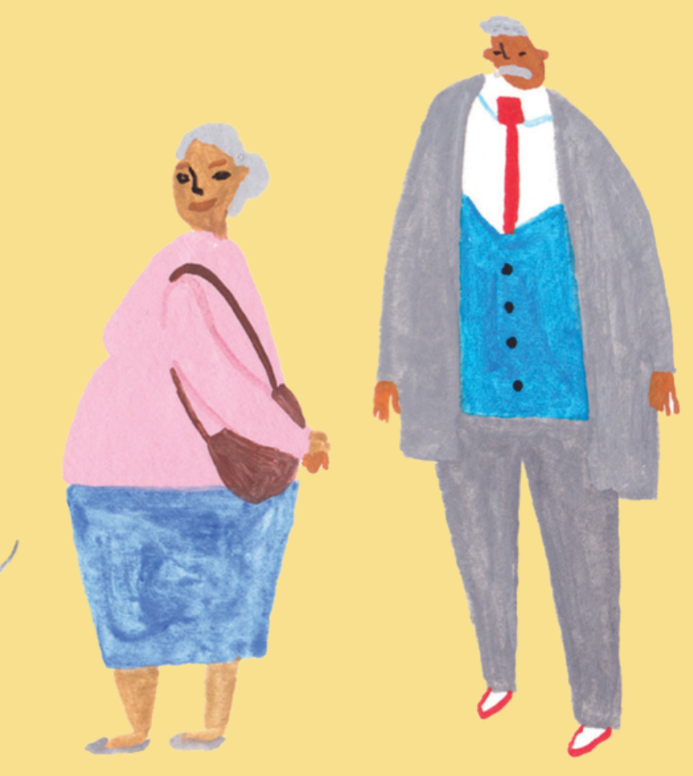
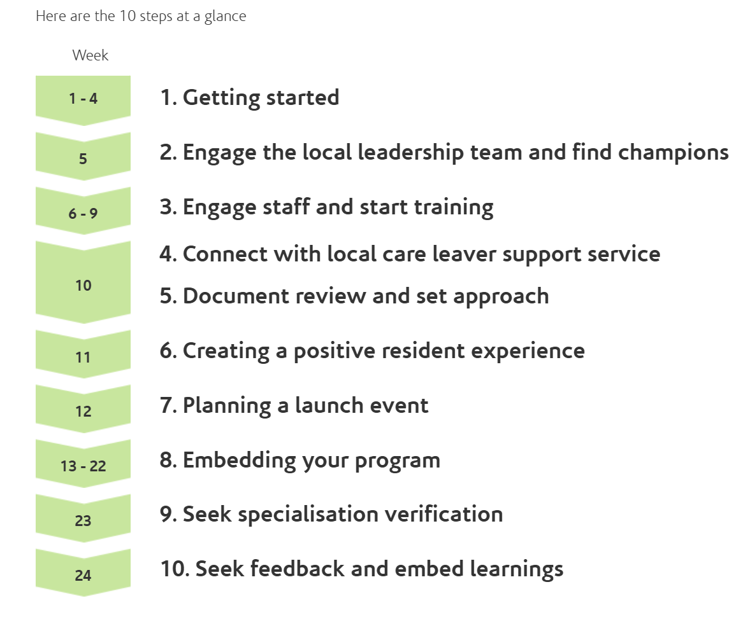
Real Care Toolkit - 10 steps to implementation website www.realcaretoolkit.com.au
Notes:
Activity: For an extended workshop, go to the toolkit website and click through the steps and resources
Discussion: how can you utilise these resources? Can there be a commitment made that we go through this process? What is our timeframe?

Slide 49
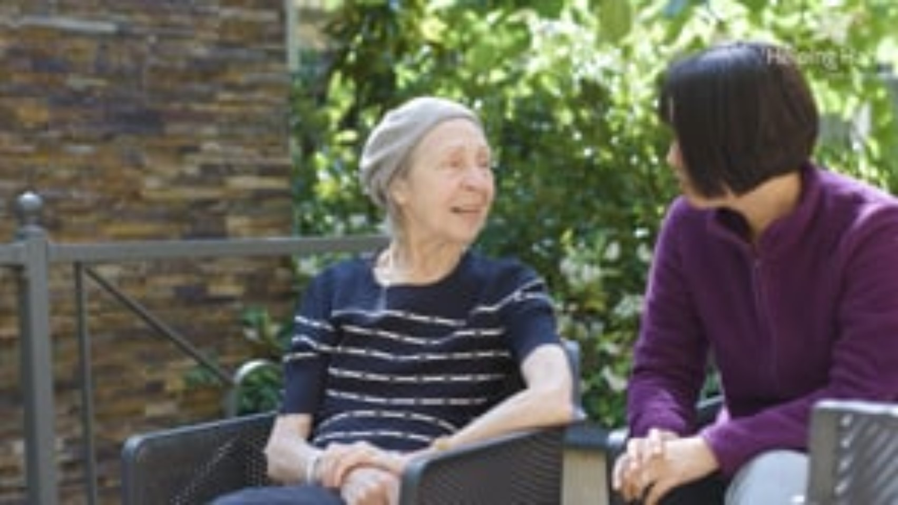
Helping carers to care
Notes:
Activity:
Intro – The consistent feedback we get about the training is that it has a huge impact – people sit back and realise that people they have cared for over the years probably have a childhood trauma – and the pieces fall into place. And when we know better, we can do better. This video goes for just under three minutes.
Invite reflections

Slide 50
Role of the Leaders and Champions
How will we champion this work?
How will we support each other?
Notes:
Activity:
Intro - This work can be confronting, distressing and difficult as we consider our own life experiences as well as those we are caring for
As leaders/champions, how will we work together to champion this work and support each other?
What will our challenges be?
Capture any actions/roles/responsibilities

Slide 51
What does this mean for staff?
Who are we going to train? And by when?
How do we support staff in training and implementation?
How will we embed this in induction?
How will we keep this alive in team meetings?
Notes:
Activity:
Capture answers to these questions, ensure EAP and pastoral care supports are identified
Note: in the toolkit there are comms for staff

Slide 52
What does this look like for our residents/clients?
First contact
Intake
Orientation
Lifestyle planning
Day to day
Clinical and other support
Family engagement
Information for prospective residents/clients
Intake questions
Feeling safe – what are the triggers? Choice and control
Connection to support services
Challenging behaviours/avoiding triggers
Days of significance
Dignity of risk – eg smoking
Visitors and strangers; sharing knowledge with care partners
Notes:
Key points:
Our trauma aware, healing informed approach should be felt by residents and clients throughout their journey with us, including assessment, service, billing, the way feedback and complaints are invited and dealt with, etc.
Information about our approach should be on our website and in materials
At intake we can ask questions like “is there anything from your childhood you want us to know about so we can care for you better”; “are there things that make you feel safe/unsafe?”
If a person discloses a care history, do they want a connection to a support service?
We can consider triggers and how to avoid them
We can ask if there are days of significance (good and bad)
We can facilitate people’s choices around the life they choose to live – eg smoking, drinking
We can share information about trauma aware practice with care partners and set out expectations if there are contractors coming on site (tools in toolkit)
Activity:
What do we need to put in place?
Capture actions

Slide 53
Likely challenges and sticking points
What might get in the way?
Is anything stopping us from embedding this?
Do we need any additional support?
Notes:
Activity:
Brainstorm on these questions, document any actions

Slide 54
Resources and contacts
Support: 13YARN
Lifeline 13 11 14
EAP
www.realcaretoolkit.com.au
Working-with-Stolen-Generations-Aged-Care-fact-sheet.pdf (healingfoundation.org.au)
https://www.helpinghand.org.au/about-us/diversity-inclusion/forgotten-australians/
clewis@helpinghand.org.au – Chelsea Lewis, Helping Hand
Notes:
Key point:
Please reach out through your support network if you need to
Maybe, before you jump into the rest of your day, have a few breaths of fresh air outside
Be gentle to yourself

